Slide 1

Auditing Upstream Petroleum Contracts
Terkimbi Ibunde
July 2022

Slide 2
Wednesday 27 July 2022
S/No | Start time | Stop time | Allotted Minutes | Activity
1 | 9:00 AM | 9:30 AM | 30 | Overview of Exploration & Production (E&P) Industry
2 | 9:30 AM | 10:30 AM | 60 | IFRS Issues in the E&P Industry
 | 10:30 AM | 10:45 AM | 15 | Tea Break
 | 10:45 AM | 12:15 PM | 90 | IFRS Issues in the E&P Industry
 | 12:15 PM | 1:15 PM | 60 | LUNCH
 | 1:15 PM | 2.45 PM | 90 | IFRS Issues in the E&P Industry
 | 2:45 PM | 3:00 PM | 15 | Tea Break
3 | 3:00 PM | 4:30 PM | 90 | Accounting and Auditing Issues in Joint Ventures (JVs)
 |  |  |  | END

Slide 3
Section 1
Overview of Upstream Business Model

Slide 4
Overview of The Upstream Business Model
–
Overview of Upstream Business Process Model
102
Facilitator
Terkimbi
Time
15 minutes

Slide 5
UPBM - Building Blocks
Overview of The Upstream Business Model
Driver Processes
Upgrade Portfolio
Explore
Develop
Produce
Abandon
Management Processes
Management
of
Assets
Execution Processes
Management
of
Processes
Management
of
Opportunities and Projects
Support Processes

Slide 6
Overview of The Upstream Business Model
Management
Processes
Driver
Processes
Upgrade Portfolio
Explore
Develop
Produce
Abandon
HC resource maturation plans
Integrated activity plans
Manage Growth Strategy and Plan*
HRVM
Manage Hydrocarbon Resource Volumes
Develop New Business*
Manage Business
Develop Exploration Business
OpCo
ASS
Manage Assets*
Manage
Business Plan
Execute Exploration Activities
Plan Hydrocarbon Development*
Manage Abandonment*
Manage
Business Management System
Execute Appraisal Activities
Develop/ Update Integrated Reservoir Model
IAP
Integrated Activity Planning*
Acquire and Process Geophysical Data
Deliver Wells
Manage Company & JVs
Design, Construct, Modify Facilities*
Decommission Facilities*
Manage
Legal Entity
(Set-up-Operate-Wind up)
Execute
Operations Readiness
and
Assurance Activities*
Produce Hydrocarbons*
Govern
Non Operated Ventures
Maintain & Assure Facilities Integrity
ORP
Opportunity Realisation Process*
Execute Well & Reservoir Surveillance
Support
Processes
Group
Group
Upstream
Group
Group
Group
Manage
Reputation
Manage Contracting & Procurement
Manage
Logistics
Manage
Finance Processes
Manage
Information
Provide HSSE & SP Support
Upstream
Group
Group
Upstream
Group
Upstream
Group
Manage
Geomatics
Provide
Real Estate Services
Manage People Processes
Manage
Technology
Manage
Legal & Compliance Processes
Manage Commercial Agreements & Relationships
Provide IT Solutions & Services
[IT Delivery Model]
6

Slide 7
Overview of The Upstream Business Model
–
Strategic Options in the Upstream Business
102
Facilitator
Terkimbi
Time
15 minutes

Slide 8
Play Choices in Exploration & Production (E&P) Industry
Overview of The Upstream Business Model
Business Model Options / Features
Explorer
Operator
Portfolio Player
Non Operator
Farm-out
Exploratory Success
Lacks financial resource to operate/produce
Appetite for frontier/emerging areas/plays/basins
Operational excellence
Excellent project management skills
Appetite for control
Full O&G value chain player
Shareholder value focused
More risk averse
Disciplined, focused investments
Farmor lacks financial and/or technical expertise
Appetite for ‘set it & forget it’ investment
Minimal involvement in management
Risk aversion
Critical Success Factors
Geoscience expertise
Technology advance
Access to acreage with decent terms
Technical Expertise
Cash flow
Operations Excellence
Stakeholder mgmt.
Strict SLAs
Legal/financial expertise
Relationship capital
Strict adherence to SLA between Farmor/farmee
Legal/financial/commercial expertise
Relationship mgmt.
Key Risks
High entry costs
Potentially limited near-term success
Exploration failure costly
Operational risks
Regulatory changes
Reputation risks
Economic factors
Arbitration risk
Operational efficiency
Complex set of agreements
Arbitration risk
Potential value erosion
Existing Coys
Anardako/Tullow
‘Old’ Shell
Esso
SunLink/Dajo Oil

Slide 9
Section 2
IFRS Issues in E&P Industry
    Accounting Approaches
    Reserves and resources
    Acquisition, Exploration, Development & Production Costs
    Assets, Depletion, Depreciation & Amortization (“DD&A”)
    Impairment of development, production and downstream assets
    Other IFRS Challenges

Slide 10
IFRS Issues in E&P Industry
–
102
Accounting Approaches
      Overview of Exploration & Development Spectrum
      Successful Efforts Method vs Full Cost Methods
Facilitator
Terkimbi
Time
15 minutes
Notes:
Two broadly acknowledged methods have traditionally been used under national GAAP to account for
Many different variants of the two methods exist.
US GAAP has had a significant influence on the development of accounting practice in this area;
Entities in those countries that may not have specific rules often follow US GAAP by analogy, and US GAAP has influenced the accounting rules in other countries.

Slide 11
IFRS Issues in E&P Industry
Overview of Exploration & Development Spectrum
Exploration Strategy Development Strategy
Regional
Frame
Assist
Volume
Challenge
Prospect
Challenge
Cluster
AFE/WP
AAR
Lead
Prospect
DG1
DG2
Discovery
Field
DG3
DG4
Rejuvenation & Evergreening
FID
Operated blocks
Blocks Operated by others
Coveted blocks (XBD)
Appraisal
Challenge
Volume
Challenge
Development
SFRin
Frame
Appraisal Plan
Assist
Appraisal well delivery
(Repeat until discovery “commercial”)
Exploration well delivery
New ideas & opportunities

Slide 12
Full Cost Method
IFRS Issues in E&P Industry
Successful Efforts Method
Expense all costs that do not result in discovery of reserves (dry hole costs)
The following:
    acquisition costs
    drilling exploration costs and
    development costs
should be treated as capital work-in-progress when incurred
All costs other than these should be charged as expense of the period
Capitalize all costs (acquisition, exploration and development costs, even dry hole costs)
Amortized using a unit-of-production method based on volumes produced and remaining proved reserves.
Notes:
First corporation to use FCM was Belco Petroleum in 1957
Because there is no known way to avoid unsuccessful costs in searching oil and gas, FCM considers both successful as well as unsuccessful costs incurred in the search for reserves as a necessary part of costs of finding oil and gas
Dry-holes are an inevitable part of exploration effort
Both, successful and unsuccessful costs are capitalized, even though unsuccessful costs have no future benefits
Debate continues within the industry on the conceptual merits of both methods although neither is wholly consistent with the IFRS framework. The IASB published IFRS 6 Exploration for and evaluation of mineral resources to provide an interim solution for E&E costs pending the outcome of the wider extractive activities project.
Successful Efforts
When the well is ready to commence commercial production, the costs referred to (2) and (3) corresponding to proved developed oil and gas reserves should be capitalized as ‘producing properties’ from capital work-in-progress to the gross block of assets
All acquisition costs should be capitalized from capital work-in-progress to the gross block of assets
If the cost of drilling exploratory well relates to a well that is determined to have no proved reserves, then such costs net of any salvage value are transferred from capital work-in-progress and charged as expense of the period

Slide 13
Temperature Check
IFRS Issues in E&P Industry
Cost items | SE | FC
Geological and Geophysical Costs (G&G)
Acquisition costs
Exploratory dry hole
Exploratory well, successful
Development dry hole
Development well, successful
Production costs

Slide 14
Suggested Solution
IFRS Issues in E&P Industry
Cost items | SE | FC
Geological and Geophysical Costs (G&G) | E | C
Acquisition costs | C | C
Exploratory dry hole | E | C
Exploratory well, successful | C | C
Development dry hole | C | C
Development well, successful | C | C
Production costs | E | E

Slide 15
IFRS Issues in E&P Industry
–
102
Reserves and Resources
Facilitator
Terkimbi
Time
45 minutes

Slide 16
IFRS Issues in E&P Industry
Overview of Hydrocarbon Matiuration Process
Exploration Development
Regional
Frame
Assist
Volume
Challenge
Prospect
Challenge
Cluster
AFE/WP
AAR
Lead
Prospect
DG1
DG2
Discovery
Field
DG3
DG4
Rejuvenation & Evergreening
FID
Operated blocks
Blocks Operated by others
Coveted blocks (XBD)
Appraisal
Challenge
Volume
Challenge
Development
SFRin
Frame
Appraisal Plan
Assist
Appraisal well delivery
(Repeat until discovery “commercial”)
Exploration well delivery
New ideas & opportunities

Slide 17
Estimation & Administration of Resource Volumes
IFRS Issues in E&P Industry
  Maintaining a robust overview of hydrocarbon resources is core business for an Upstream company
  The Annual Review of Petroleum Resources (ARPR) combines all Resource Volumes
  The upstream company portfolio
  Input into External report(s)
Internal Use (incl. planning)
Required to monitor the business, make decisions and set direction
Resource estimates and classifications are used in various business activities
External Requirements
Local Requirements: Authorities require reporting of Resource Volumes for valuation of national resources
External Disclosure: Mandatory requirement for companies listed on NY Stock Exchange (SEC)
RRR (Reserves Replacement Ratio) used by analysts
Notes:
Exploration, development and production of hydrocarbons is Upstream company’s core business.
Internal Use
Business Decisions (IP/FID and ORP Decision Gates)
Business Planning and Strategy Development
Business Performance Indicators
Quarterly Flux delivery LE/LV
Quarterly earnings calculations
Categories in Red Font are captured in ARPR while full ranges are retained locally
External Disclosure
Mandatory requirement for companies listed on any Stock Exchange
External Disclosure of SEC Proved. SEC/FASB rules apply for Annual Report/20F if an upstream company is listed on the New York Stock Exchange
Used by investors for company valuation
We also disclose volume data in Strategy Presentations to media and analysts (RRR, R/P, Resources, etc.)

Slide 18
IFRS Issues in E&P Industry
The SPE Petroleum Resource Management System (PRMS)
PRODUCTION
Project Maturity
COMMERCIAL
RESERVES
Developed
Must be economic
Proved SEC
2P
3P
(1P)
Best
High
Undeveloped
1C
2C
3C
Economic viability qualification increases with maturity (most sub-classes require NPV DF > 0 @ PSV-RV, some have POS and different PSVs
DISCOVERED PIIP
CONTINGENT
Development Pending various Decision Gates
RESOURCES
SUB-COMMERCIAL
Increasing Chance of Commerciality
TOTAL PETROLEUM INITIALLY-IN-PLACE (PIIP)
Development Unclarified
1C
2C
3C
Development On Hold
Low
Best
High
Development Not Viable
Post Licence (CR)
Unrecoverable
PROSPECTIVE
Prospect
Prospective volumes that are potentially economic
EMV DF > 0 PSV-RV / HV
RESOURCES
Lead
UNDISCOVERED PIIP
1U
2U
3U
Play
Low
Expectation
High
Post License (PR)
Unrecoverable
Red = Mandatory
Range of Uncertainty
Notes:
The one slide to remember
Resources can be reported only if a company (affiliate) has or shares development rights/obligations
Prospective Resources are those quantities of petroleum which are estimated, as of a given date, to be potentially recoverable from undiscovered accumulations
Undiscovered, potentially economically recoverable
Contingent Resources: Discovered quantities of petroleum estimated, as of a given date, to be potentially recoverable from known accumulations by application of development projects, but which are not currently considered Technically and/or Commercially mature
In other words: Discovered hydrocarbon accumulations that are being studied but which have not been sanctioned yet and development is still subject to FID (internal) and permission & contracts (external)
Reserves: Technically and Commercially Mature
Reserves are those quantities of petroleum anticipated to be commercially recoverable by application of development projects to known accumulations from a given date forward under defined conditions. They must be
Discovered
Recoverable
Commercial
Remaining (i.e. not yet produced)

Slide 19
IFRS Issues in E&P Industry
Petroleum Resource Classification System
  Prospective Resources are those quantities of petroleum which are estimated, as of a given date, to be potentially recoverable from undiscovered accumulations
  Three main Sub-classes
    Prospect
    Play
    Lead
    Post Licence (PR)
  Contingent Resources are those quantities of petroleum estimated, as of a given date, to be potentially recoverable from known accumulations by application of development projects, but which are not currently considered to be commercially recoverable due to one or more contingencies
  Reserves are those quantities of petroleum anticipated to be commercially recoverable by application of development projects to known accumulations from a given date forward under defined conditions. They must be
    Discovered
    Recoverable
    Commercial
    Remaining (i.e. not yet produced)

Slide 20
IFRS Issues in E&P Industry
Contingent Resources versus Reserves
Contingent Resources
Discovered quantities of petroleum estimated, as of a given date, to be potentially recoverable from known accumulations by application of development projects, but which are not currently considered Technically and/or Commercially mature
Reserves
Discovered recoverable volumes of petroleum resources associated with a project that is deemed technically and commercially mature
Technical Maturity
Approved “Operator” FDP with reasonable expectation of being implemented
Reasonable expectation that no Technical Showstoppers will materialise
Commercial Maturity
Project profitability meets company’s current investment screening criteria
Market availability is assured,
Intent of Project execution is firm
Reasonable expectation that no commercial show stoppers will materialise

Slide 21
IFRS Issues in E&P Industry
Definitions of Uncertainty Range
The range of uncertainty of the recoverable and /or potentially recoverable volumes may be represented by either deterministic scenarios or by a probability distribution
For Contingent Resources and Reserves, probabilistic estimates must be supported by appropriate deterministic estimates aligned with feasible development scenarios.
SEC Proved/1C denote Low estimates (P90), i.e. High confidence estimate
2P/2C denote Best estimates (P50)
3P/3C denote High estimates (P10) i.e. Lower confidence, high side estimate
2U = POS * Mean Success Volume
P50
P90
P10
SEC Proved
2P
3P
1C
2C
3C
1U
2U* (Mean)
3U
Notes:
The range of uncertainty of the recoverable and /or potentially recoverable volumes may be represented by either deterministic scenarios or by a probability distribution
For Contingent Resources and Reserves, probabilistic estimates must be supported by appropriate deterministic estimates aligned with feasible development scenarios.
1P/1C denote Low estimates (P90), i.e. High confidence estimate
For 1P reserves: reasonable certainty, high confidence that the quantities will be recovered
2P/2C denote Best estimates (P50)
The most realistic assessment of recoverable quantities
3P/3C denote High estimates (P10) i.e. Lower confidence, high side estimate
A realisable high estimate based on proposed 2P development
Note distribution in figure is asymmetric but can attain different shapes dependent on circumstances

Slide 22
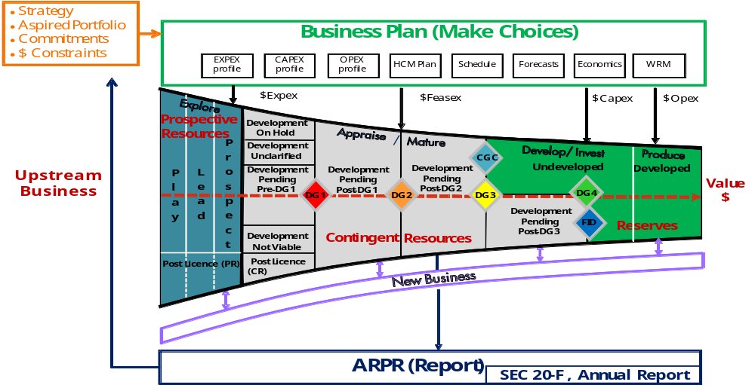
IFRS Issues in E&P Industry
Hydrocarbon maturation Funnel
Notes:
The ELT, with qualifying UDETs and PD profiles, must meet two conditions
Cumulative net cash flow must go positive (exceeding future development, decommissioning and restoration costs) at some point in the future, if not, there are no Proved reserves.
The Proved production forecast is then truncated in the year that the annual net operating cash flow goes negative (thus achieving the maximum cumulative net cash flow) unless already truncated earlier for technical, operational or contractual reasons.
Reserves are defined up to truncation point.

Slide 23
IFRS Issues in E&P Industry
Reserves must be Economic
Best & High (2P-3P) estimates are evaluated at Oilco’s Economics (PSV, post-tax, discounted)
SEC Proved Reserves are evaluated at SEC economics (YAP, pre-tax, undiscounted)
  Projects must be economic, i.e. yield a positive cumulative cash flow
  Reserves are defined up to truncation point (unless license or technical cut-off precedes)
Cumulative cash flow positive
Resource Truncation
Annual cash flow goes negative
Notes:
The ELT, with qualifying UDETs and PD profiles, must meet two conditions
Cumulative net cash flow must go positive (exceeding future development, decommissioning and restoration costs) at some point in the future, if not, there are no Proved reserves.
The Proved production forecast is then truncated in the year that the annual net operating cash flow goes negative (thus achieving the maximum cumulative net cash flow) unless already truncated earlier for technical, operational or contractual reasons.
Reserves are defined up to truncation point.

Slide 24
Reserves : Criteria for Technical & Commercial Maturity
IFRS Issues in E&P Industry
Reserves need to be Technically and Commercially Mature
The same level of maturity is required for SEC Proved, 2P and 3P Reserves
Technical Maturity (T)
  Oilco approved (operator) FDP with reasonable expectation of being implemented
  Reasonable expectation that no Technical Showstoppers will materialise
Commercial / Non-Technical Maturity (ECOP)
  Project profitability meets current investment screening criteria
  Market availability is assured,
  Intent of Project execution is firm
  Reasonable expectation that no other show stoppers will materialise
  (including government, partners, legal, contractual, political, environmental or other social/economic concerns) – For PSCs formal Government approval is required

Slide 25
Disclosure of Reserves and Resources
IFRS Issues in E&P Industry
Overview
The disclosure of key assumptions and key sources of estimation uncertainty at the balance sheet date is required by IAS 1. Given that the reserves and resources have a pervasive impact, this normally results in entities providing disclosure about hydrocarbon resource and reserve estimates, for example:
  the methodology used and key assumptions made for hydrocarbon resource and reserve estimates
  the range of reasonably possible outcomes within the next financial year in respect of the carrying amounts of the assets and liabilities affected
  an explanation of changes made to past hydrocarbon resource and reserve estimates, including changes to underlying key assumptions.
Other information such as the potential future costs to be incurred to acquire, develop and produce reserves may help users of financial statements to assess the entity’s performance. Supplementary disclosure of such information with IFRS financial statements is useful, but it should be consistently reported, and the underlying basis clearly disclosed and based on common guidelines or practices, such as the Society of Petroleum Engineers definitions
Notes:
A key indicator for evaluating the performance of oil and gas entities is their existing reserves and the future production and cash flows expected from them. Some national GAAPs and securities regulators require supplemental disclosure of reserve information, most notably the FASB ASC 932 and Securities and Exchange Commission (SEC) regulations. There have also been recommendations on accounting practices issued by industry bodies such as the UK Statements of Recommended Practice (SORPs) – which cover Accounting for Oil and Gas Exploration, Development, Production and Decommissioning Activities. However, there are no reserve disclosure requirements under IFRS.
IAS 1 Presentation of financial statements [IAS 1 para 17] requires that an entity’s financial statements should provide additional information when compliance with specific requirements in IFRS is insufficient to enable an entity to achieve a fair presentation.
An entity may consider the pronouncements of other standard-setting bodies and accepted industry practices when developing accounting policies in the absence of specific IFRS guidance. Many entities provide supplemental information with the financial statements because of the unique nature of the oil and gas industry and the clear desire of investors and other users of the financial statements to receive information about reserves. The information is usually supplemental to the financial statements, and is not covered by the auditor’s opinion.
Information about quantities of oil and gas reserves is essential for users to understand and compare oil and gas companies’ financial position and performance. Entities should consider presenting reserve quantities and changes on a reasonably aggregated basis. Where certain reserves are subject to particular risks, those risks should be identified and communicated. Reserve disclosures accompanying the financial statements should be consistent with those reserves used for financial statement purposes. For example, proven and probable reserves or proved reserves might be used for depreciation, depletion and amortisation calculations.
The categories of reserves used and their definitions should be clearly described. Reporting a ‘value’ for reserves and a common means of measuring that value have long been debated, and there is no consensus among national standard-setters permitting or requiring value disclosure. There is, at present, no globally agreed method to prepare and present ‘value’ disclosures. However, there are globally accepted engineering definitions of reserves that take into account economic factors. These definitions may be a useful benchmark for investors and other users of financial statements to evaluate.
Supplementary disclosure of such information with IFRS financial statements is useful, but it should be consistently reported, and the underlying basis clearly disclosed and based on common guidelines or practices, such as the Society of Petroleum Engineers definitions

Slide 26
Disclosure of Reserves and Resources
IFRS Issues in E&P Industry
Disclosure of E&E and production expenditure
Exploration and development costs that are capitalised should be classified as non-current assets in the balance sheet. They should be separately disclosed in the financial statements and distinguished from producing assets where material [IFRS 6 para 23]. The classification as tangible or intangible established during the exploration phase should be continued through to the development and production phases. Details of the amounts capitalised and the amounts recognised as an expense from exploration, development and production activities should be disclosed..
SEC rules on disclosure of resources
SEC guidance on the disclosure of reserves is viewed by the industry as a best practice approach to disclosure. Oil and gas entities may prepare their reserves disclosures based on this guidance even where they are not SEC-listed. The SEC amended its guidance on disclosure requirements (The Final Rule) and this has been in effect since December 2009.
Notes:
A key indicator for evaluating the performance of oil and gas entities is their existing reserves and the future production and cash flows expected from them. Some national GAAPs and securities regulators require supplemental disclosure of reserve information, most notably the FASB ASC 932 and Securities and Exchange Commission (SEC) regulations. There have also been recommendations on accounting practices issued by industry bodies such as the UK Statements of Recommended Practice (SORPs) – which cover Accounting for Oil and Gas Exploration, Development, Production and Decommissioning Activities. However, there are no reserve disclosure requirements under IFRS.
IAS 1 Presentation of financial statements [IAS 1 para 17] requires that an entity’s financial statements should provide additional information when compliance with specific requirements in IFRS is insufficient to enable an entity to achieve a fair presentation.
An entity may consider the pronouncements of other standard-setting bodies and accepted industry practices when developing accounting policies in the absence of specific IFRS guidance. Many entities provide supplemental information with the financial statements because of the unique nature of the oil and gas industry and the clear desire of investors and other users of the financial statements to receive information about reserves. The information is usually supplemental to the financial statements, and is not covered by the auditor’s opinion.
Information about quantities of oil and gas reserves is essential for users to understand and compare oil and gas companies’ financial position and performance. Entities should consider presenting reserve quantities and changes on a reasonably aggregated basis. Where certain reserves are subject to particular risks, those risks should be identified and communicated. Reserve disclosures accompanying the financial statements should be consistent with those reserves used for financial statement purposes. For example, proven and probable reserves or proved reserves might be used for depreciation, depletion and amortisation calculations.
The categories of reserves used and their definitions should be clearly described. Reporting a ‘value’ for reserves and a common means of measuring that value have long been debated, and there is no consensus among national standard-setters permitting or requiring value disclosure. There is, at present, no globally agreed method to prepare and present ‘value’ disclosures. However, there are globally accepted engineering definitions of reserves that take into account economic factors. These definitions may be a useful benchmark for investors and other users of financial statements to evaluate.
Supplementary disclosure of such information with IFRS financial statements is useful, but it should be consistently reported, and the underlying basis clearly disclosed and based on common guidelines or practices, such as the Society of Petroleum Engineers definitions

Slide 27
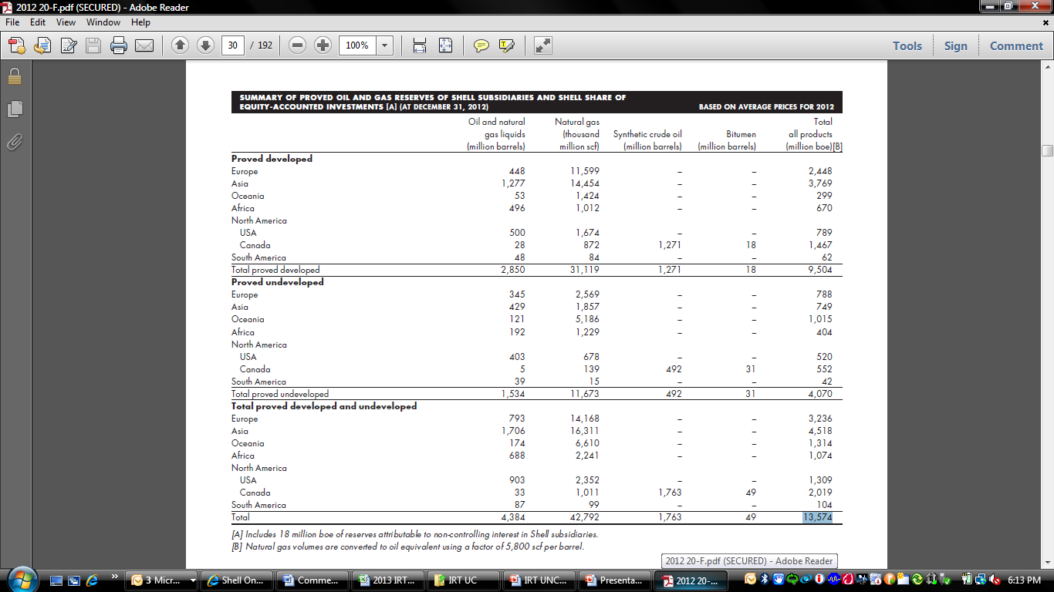
Reporting
IFRS Issues in E&P Industry
Annual Report/20-F includes:
    An overview of Proved Oil & Gas reserves
    Standardized Measure of Oil & Gas (SMOG)
      Economic valuation of the company based on its proved oil & gas reserves and standard metrics
      Not meant to represent the actual value, but to provide a consistent measure for analysts and shareholders to compare Upstream companies
Notes:
Oil and gas producing activities’ include sources of oil and gas from unconventional sources, including bitumen, oil sands and hydrocarbons extracted from coalbeds and oil shale. Reserve definitions are aligned with those from the Petroleum Resources Management System (PRMS) approved by the Society for Petroleum Engineers (SPE).
The definition of ‘proved oil and gas reserves’ is “the estimated quantities of crude oil, natural gas, and natural gas liquids which geological and engineering data demonstrate with reasonable certainty to be recoverable in future years from known reservoirs under existing economic and operating conditions” [Rule 4-10a].
Key criteria to meet this definition are:
There must be at least a 90% probability that the quantities actually recovered will equal or exceed the stated volume (consistent with PRMS) to achieve the definition of ‘Reasonable certainty’.
The reserves must be ‘Economically producible’ and this requires the use of average prices during the prior 12-month period.
To extract the reserves there must be ‘Reliable technology’: this refers to technology that has been field tested and demonstrated consistency and repeatability in the formation being evaluated or in an analogous formation.
Probable and possible reserve estimates allow the use of deterministic and probabilistic methods.
The Final Rule is silent with respect to the treatment of the reserves of an equity method investment. The ASU, however, requires entities to separately disclose the significant oil and gas producing activities of their equity method investments at the same level of detail as consolidated investments (i.e. including Topic ASC 932 supplemental disclosures).
Disclosure of E&E and production expenditure
Exploration and development costs that are capitalised should be classified as non-current assets in the balance sheet. They should be separately disclosed in the financial statements and distinguished from producing assets where material [IFRS 6 para 23]. The classification as tangible or intangible established during the exploration phase should be continued through to the development and production phases. Details of the amounts capitalised and the amounts recognised as an expense from exploration, development and production activities should be disclosed..
If a company represents that disclosure is based on the authority of a third party that prepared the reserves estimates or conducted a reserves audit or process review, they should also file a report prepared by the third party.

Slide 28

IFRS Issues in E&P Industry
In Summary - Reserves and Resources
Reserve talk
• Under U.S. GAAP, only proved reserves are allowed to be booked
• Under IFRS, companies are allowed to book both proved and probable reserves.
Estimated Reserves
Proved Reserves
Probable Reserves
Pos
sible Reserves
More reserve talk
• 1P or P = proved reserves
• 2P = Proved + probable
reserves
• 3P = Proved + probable +
possible reserves
Proved
Developed
Proved
Undeveloped
Notes:
Proved reserves – we’re fishing and the fish is most
certainly in our net
• Commercially recoverable under current economic conditions (both in terms of prices and costs) and currently available technology.
• Highly certain to be recovered – must be a 90% chance that actual reserves will be larger than this estimate.
Proved Developed
Reserves that are expected to be produced from existing wells.
Can be producing – proved developed producing(PDP).
Not yet producing – proved developed non-producing(PDNP).
Proved Undeveloped (PUD)
• Reserves that are expected to be produced from new wells.
Probable reserves – we’re fishing and we see fish in the
water
• Unproved reserves that are likely to be recoverable.
• Should be at least 50% chance of being technically and economically producible.
Possible reserves – we’re fishing and we think there is
fish in the water
Estimated to have a significant, but less than 50
percent chance of being technically and economically
producible.

Slide 29
15 Minutes
IFRS Issues in E&P Industry
We’ll resume our meeting in:

Slide 30
IFRS Issues in E&P Industry
–
Acquisition, Exploration, Development & Production Costs
        Overview of Exploration and Production (E&P) Costs
        Overview of Opportunity Maturation Process
        Depletion, Depreciation & Amortization (IFRS 6, IAS 8)
        Impairment of Development & Production assets ( IAS 36)
102
Facilitator
Terkimbi
Time
50 minutes

Slide 31




IFRS Issues in E&P Industry
Temperature Check
• performing a number of geological evaluations/surveys to determine hydrocarbon presence
• activities relating to securing the rights from the property owner to explore for and produce oil & gas in that field/area.
•
• Drilling exploration wells to determine if commercial hydrocarbon quantities exist.
• Cnfirming the initial exploration results through appraisal wells drilled to gain further insight into the property, including the size of the reservoir.
• Involves activities relating to developing the discovered O&G reserves for production.
Notes:
Exploration
Prospecting activities conducted in the search for oil and gas
Ariel, geological, geophysical, geochemical, topographical and seismic surveys
Analysis, studies and their interpretation
Investigations relating to subsurface geology
Structural test drilling
Drilling of exploratory and appraisal wells
Exploration Costs include:
Costs incurred in exploring property
Costs of surveys and studies (like aerial, geological, geophysical, geochemical, and seismic surveys)
Costs of environment clearance, defense clearance, etc.
Salaries and other expenses of geologists, etc.
Costs of carrying and retaining undeveloped properties, such as delay rental, maintenance of land, annual license fees in respect of PEL

Slide 32
IFRS Issues in E&P Industry
Temperature Check
• performing a number of geological evaluations/surveys to determine hydrocarbon presence
• activities relating to securing the rights from the property owner to explore for and produce oil & gas in that field/area.
•
• Drilling exploration wells to determine if commercial hydrocarbon quantities exist.
• Cnfirming the initial exploration results through appraisal wells drilled to gain further insight into the property, including the size of the reservoir.
• Involves activities relating to developing the discovered O&G reserves for production.
Prospecting
Acquisitions
Exploration (drilling)
Evaluation and appraisal
Development
Notes:
Exploration
Prospecting activities conducted in the search for oil and gas
Ariel, geological, geophysical, geochemical, topographical and seismic surveys
Analysis, studies and their interpretation
Investigations relating to subsurface geology
Structural test drilling
Drilling of exploratory and appraisal wells
Exploration Costs include:
Costs incurred in exploring property
Costs of surveys and studies (like aerial, geological, geophysical, geochemical, and seismic surveys)
Costs of environment clearance, defense clearance, etc.
Salaries and other expenses of geologists, etc.
Costs of carrying and retaining undeveloped properties, such as delay rental, maintenance of land, annual license fees in respect of PEL

Slide 33

IFRS Issues in E&P Industry
E&P costs
Acquisition
Costs
Exploration
Costs
Development
Costs
Production
Costs
Capitalized (B/S) Amortized (I/S)
Depends
Capitalized (B/S) Amortized (I/S)
Expensed (I/S)
Notes:
Acquisition
Involves activities relating to securing the rights from the property owner to explore for and produce oil & gas in that field/area.
Fiscal terms surrounding property acquisitions (what is owned by the oil companies versus original land owners/government) are complex;
Exploration
Areas that may warrant examination, such as:
topographical, geological and geophysical (‘G & G’) studies and related activities undertaken in the exploration and appraisal phases;
carrying and retaining undeveloped concessions, such as delay rentals, legal costs for title defence and the maintenance of land and lease records; making dry hole and bottom hole contributions to other parties
Areas that are considered to have prospects of containing oil and gas reserves, such as: drilling and equipping exploratory wells; and drilling exploratory-type stratigraphic test wells.
Development
preparing proved reserves for production, i.e. all activities undertaken to obtain access to proved reserves and to provide facilities for extracting, treating, gathering, and storing oil and gas
Production
Pre-wellhead - lifting the oil and gas to the surface, operation and maintenance of wells, extraction rights, etc
Post-wellhead - gathering, treating, field transportation, field processing, etc., up to the outlet valve on the lease or field production storage tank, etc
Include:
Costs of clearing ground, draining, road building, gas lines and power lines to the extent necessary in developing the proved oil and gas reserves
Costs to drill and equip development wells and service wells including costs of platforms and well equipment such as casing, tubing, pumping equipment, etc.
Costs to acquire, construct and install production facilities such as lease flow lines, separators, treaters, heaters, manifolds, measuring devices and production storage tanks, natural gas cycling and processing plants and utility and waste disposal systems
Depreciation and applicable operating cost of related support equipment and facilities in connection with development activities, and annual license fees in respect of ML
Purchase, shipment or storage of equipment and materials used in developing oil and gas accumulations, completion of successful exploration wells
Drilling, completion and testing of development wells
Drilling, completion and recompletion of service wells
Laying of gathering lines
Construction of offshore platforms and installations
Installations of separators, tankages, pumps, artificial lifts and other producing and injection facilities required to produce, process and transport oil or gas

Slide 34
IFRS Issues in E&P Industry
E&P costs
Acquisition
Costs
Exploration
Costs
Development
Costs
Production
Costs
Capitalized (B/S) Amortized (I/S)
Depends
Capitalized (B/S) Amortized (I/S)
Expensed (I/S)
Notes:
Acquisition
Involves activities relating to securing the rights from the property owner to explore for and produce oil & gas in that field/area.
Fiscal terms surrounding property acquisitions (what is owned by the oil companies versus original land owners/government) are complex;
Exploration
Areas that may warrant examination, such as:
topographical, geological and geophysical (‘G & G’) studies and related activities undertaken in the exploration and appraisal phases;
carrying and retaining undeveloped concessions, such as delay rentals, legal costs for title defence and the maintenance of land and lease records; making dry hole and bottom hole contributions to other parties
Areas that are considered to have prospects of containing oil and gas reserves, such as: drilling and equipping exploratory wells; and drilling exploratory-type stratigraphic test wells.
Development
preparing proved reserves for production, i.e. all activities undertaken to obtain access to proved reserves and to provide facilities for extracting, treating, gathering, and storing oil and gas
Production
Pre-wellhead - lifting the oil and gas to the surface, operation and maintenance of wells, extraction rights, etc
Post-wellhead - gathering, treating, field transportation, field processing, etc., up to the outlet valve on the lease or field production storage tank, etc
Include:
Costs of clearing ground, draining, road building, gas lines and power lines to the extent necessary in developing the proved oil and gas reserves
Costs to drill and equip development wells and service wells including costs of platforms and well equipment such as casing, tubing, pumping equipment, etc.
Costs to acquire, construct and install production facilities such as lease flow lines, separators, treaters, heaters, manifolds, measuring devices and production storage tanks, natural gas cycling and processing plants and utility and waste disposal systems
Depreciation and applicable operating cost of related support equipment and facilities in connection with development activities, and annual license fees in respect of ML
Purchase, shipment or storage of equipment and materials used in developing oil and gas accumulations, completion of successful exploration wells
Drilling, completion and testing of development wells
Drilling, completion and recompletion of service wells
Laying of gathering lines
Construction of offshore platforms and installations
Installations of separators, tankages, pumps, artificial lifts and other producing and injection facilities required to produce, process and transport oil or gas

Slide 35
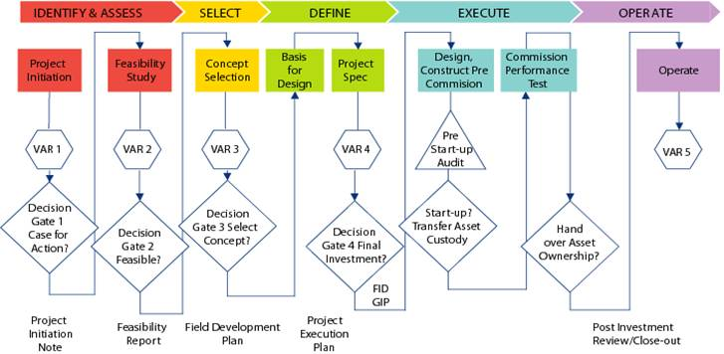
Overview of Opportunity Maturation Process
IFRS Issues in E&P Industry
The different stages of a project are as shown:
IDENTIFY
ASSESS
Pre-FID Costs
Post-FID Costs
Operating Costs
General Rule - EXPENSE, CAPITALIZE EXPENSE

Slide 36
Special Cases
IFRS Issues in E&P Industry
Exploration Phase
License Relinquishment
Pre-FID Phase: Identify, Assess, Select & Define
Long lead items (LLIs)
Post –FID: Execute (Facility Construction Phase)
Sidetracks
Suspended well
Operate – Production Phase
Workovers
Replacement of wells
Plug and Abandon
Well deepening and converting a well
Replacement and renewal of assets
Alterations and modifications
Movables
Notes:
Performing exploratory drilling at a particular location can indicate that reserves are present in a nearby location rather than the original target. It may be cost-effective to “side track” from the initial drill hole to the location of reserves instead of drilling a new hole. If this side track is successful in locating reserves, the cost previously incurred on the original target can remain capitalised instead of being written off as a dry hole. The additional costs of the side track are treated in accordance with the company’s accounting policy which should be followed consistently. The asset should be considered for impairment if the total cost of the asset has increased significantly. If the additional drilling is unsuccessful, all costs would be expensed.
Solution to side track question
No costs will be written off as the drilling has proved successful.

Slide 37
IFRS Issues in E&P Industry
–
102
Depletion, Depreciation & Amortization (IFRS 6, IAS 8)
Facilitator
Terkimbi
Time
5 minutes

Slide 38



IFRS Issues in E&P Industry
DD&A key points
Depreciation
• A method by which the cost of long-term fixed assets (over 1 year) is spread over a future period (number of years), when these assets are expected to be in service and help generate revenue for a company.
• An allocation of the costs of an original purchase of fixed assets over the estimated useful lives of those fixed assets.
Depletion
• O&G industry specific
• Same concept as depreciation that is applied to mineral resources.
Amortization
• Amortization is the systematic allocation of the cost of
acquired intangible assets over a period of time that
What’s depreciated?
Fixed assets:
• Plants
• Machinery
• Drilling equipment
• Pipelines
What’s depleted?
• O&G reserves
What’s amortized?
Acquired intangible assets:
• Brand
• Franchise
• Trademarks
• Patents
these assets are expected to be in service and help
generate revenue for a company.
All 3 appear on the income statement
• Combined into 1 line item: Depreciation, Depletion, and Amortization (or DD&A).
17

Slide 39
IFRS Issues in E&P Industry
–
Impairment of Development & Production assets ( IAS 36)
102
Facilitator
Terkimbi
Time
5 minutes

Slide 40
IFRS Issues in E&P Industry
Impairment indicators in Oil and gas industry
  Industry characterized by significant capital investment required and volatility in process
  Assets should be tested for impairment whenever indicators of impairment exist [IAS 36)
  Measurement rules apply to assets with the exception of the grouping of E&E assets with existing producing cash generating units (CGUs)
  Recognise Impairments f a CGU’s carrying amount exceeds its recoverable amount
  Recoverable amount is the higher of fair value less costs to sell and value in use (VIU).
  Impairments triggers
  declining long-term market prices for oil and gas,
  significant downward reserve revisions
  increased regulation or tax changes, and
  deteriorating local conditions such that it may become unsafe to continue operations and expropriation of assets.

Slide 41
IFRS Issues in E&P Industry
–
Other IFRS Challenges
        Borrowing Costs (IFRS 6, IAS 23)
        Foreign Currency Gains and Losses (!AS 21, 23)
        Revenue Recognition (IFRS 15)
        Business Combinations (IFRS 3)
        Joint Arrangements (IFRS 11
        Decommissioning (Assets Retirement Obligations) – IAS 37
102
Facilitator
Terkimbi
Time
50 minutes

Slide 42
IFRS Issues in E&P Industry
–
102
Borrowing Costs (IFRS 6, IAS 23)
Facilitator
Terkimbi
Time
5 minutes

Slide 43
Borrowing costs:
IFRS Issues in E&P Industry
  Should be capitalize under IFRS 6 as a cost of E&E if capitalized under previous GAAP.
  May also capitalise on any E&E assets that meet the asset recognition criteria in their own right and are qualifying assets under IAS 23.
  Cost of an item of property, plant and equipment may include borrowing costs incurred for the purpose of acquiring or constructing it. IAS 23 Borrowing costs requires that borrowing costs be capitalised in respect of qualifying assets.
    Qualifying assets are those assets which take a substantial period of time to get ready for their intended use.
  Should be capitalised while acquisition or construction is actively underway.
  include the costs of specific borrowings for the purpose of financing the construction of the asset, and those general borrowings that would have been avoided if the expenditure on the qualifying asset had not been made.
Notes:
Entities could develop an accounting policy under IFRS 6 to cease capitalisation of borrowing costs if these were previously capitalised. However, the entity would then need to consider whether borrowing costs relate to a qualifying asset and would therefore require capitalisation. The asset would have to meet the IASB framework definition of an asset and be probable of generating future economic benefit. This definition will not be met for many assets. An exploration licence, for example, would not meet the definition of a qualifying asset as it is available for use in the condition it is purchased and does not take a substantial period of time to get ready for use. Additional exploration expenditure, although it can be capitalised under IFRS 6, would not be considered probable of generating future economic benefit until sufficient reserves are located.

Slide 44
IFRS Issues in E&P Industry
–
Revenue Recognition (IFRS 15)
102
Facilitator
Terkimbi
Time
10 minutes

Slide 45
IFRS Issues in E&P Industry
Overlift and underlift
  Joint ventures (JV) share the physical output, such as crude oil, between the joint venture partners. Each JV partner is responsible for either using or selling the oil it takes.
  The physical nature of production and transportation of oil is such that it is often more efficient for each partner to lift a full tanker-load of oil.
  A lifting schedule identifies the order and frequency with which each partner can lift.
  The amount of oil lifted by each partner at the balance sheet date may not be equal to its working interest in the field.
  Some partners will have taken more than their share (overlifted) and others will have taken less than their share (underlifted).
Notes:
Revenue recognition, particularly for upstream activities, can present challenging issues. Production often takes place in joint ventures or through concessions, and entities need to analyse the facts and circumstances to determine when and how much revenue to recognise. Crude oil and gas may need to be moved long distances and need to be of a specific type to meet refinery requirements. Entities may exchange product to meet logistical, scheduling or other requirements. This section looks at these common issues. Revenue recognition in production-sharing agreements (PSAs) is discussed in section
Overlift/underlift
Many joint ventures (JV) share the physical output, such as crude oil, between the joint venture partners. Each JV partner is responsible for either using or selling the oil it takes.
The physical nature of production and transportation of oil is such that it is often more efficient for each partner to lift a full tanker-load of oil. A lifting schedule identifies the order and frequency with which each partner can lift. The amount of oil lifted by each partner at the balance sheet date may not be equal to its working interest in the field. Some partners will have taken more than their share (overlifted) and others will have taken less than their share (underlifted).

Slide 46
Onerous contracts
IFRS Issues in E&P Industry
  contract in which the unavoidable costs of meeting the obligations under the contract exceed the economic benefits expected to be received under it
  unavoidable costs under a contract reflect the least net cost of exiting from the contract, which is the lower of the cost of fulfilling it and any compensation or penalties arising from failure to fulfil it.
  onerous contract would likely trigger impairment trigger and will require IAS 36 treatment
Illustrative example
  An oil and gas company entered into a fixed price long-term supply contract with a customer. The cost of extraction and/or production increases subsequently and the total cost to fulfil the contract is expected to exceed the contract price.
Notes:
.

Slide 47
IFRS Issues in E&P Industry
–
Business Combinations (IFRS 3)
102
Facilitator
Terkimbi
Time
10 minutes
Notes:
Acquisition of assets and businesses are common in oil and gas (O&G). Over the past few years, market conditions have been challenging. Acquisitive entities that seek to secure access to reserves or replace depleting reserves face a variety of accounting issues due to significant changes in the accounting for merger and acquisition transactions. This adds more complexity to the already challenging economic conditions.
Definition of a business
A business is a group of assets that includes inputs, outputs and processes that are capable of being managed together for providing a return to investors or other economic benefits. Not all of the elements need to be present for the group of assets to be considered a business. Significant judgement is required in the determination of what is a business.
Upstream activities in the production phase will typically represent a business, whereas those at the exploration stage will typically represent a collection of assets. A licence to explore, on its own, is normally just an asset. If a number of assets are owned and there are additional processes which exist to manage that portfolio, it might represent a business. Projects that lie in the development stage are more difficult to judge and will require consideration of the stage of development and other relevant factors. A development project with significant infrastructure costs remaining and no potential customers is more likely to be an asset. As these matters are resolved and the projects gets closer to the production stage, the evaluation as to whether an asset or business exists becomes more complicated. Each acquisition needs to be evaluated based on the specific facts and circumstances.

Slide 48
IFRS Issues in E&P Industry
Overview
  A business combination will usually result in the recognition of goodwill and deferred tax.
  If the assets purchased do not constitute a business, the acquisition is accounted for as the purchase of individual assets. The distinction is important because, in an asset purchase:
      no goodwill is recognised;
      deferred tax is generally not recognised for asset purchases (initial recognition exemption (IRE) in IAS 12 Income taxes does not apply to business combinations);
      transaction costs are generally capitalised; and
      asset purchases settled by the issue of shares are within the scope of IFRS 2 Share-based payments.
  Difference between business combinations and purchase of assets
  IFRS 3 defines a business as “consisting of inputs and processes applied to those inputs that have the ability to create output”. All three elements – input, process and output – should be considered in determining whether a business exists.

Slide 49
IFRS Issues in E&P Industry
Identifying a Business Combination
  Transactions could be purchase of shares, purchase of net assets, a new company that takes over existing businesses and restructuring of existing entities.
  A number of transactions linked together, or contingent on completion of each other, need to be considered as a whole.
  Focus is on substance of transactions and not the legal form .
  Exemptions to applying business combination accounting under IFRS are:
      when the assets acquired do not constitute a business (as discussed above);
      formation of a joint arrangement in the financial statements of the joint arrangement itself and
      businesses that are under common control (where no change in ownership takes place).
  A business combination occurs when control is obtained. Both existing voting rights and capacity to control in the form of currently exercisable options and rights are considered in determining when control or capacity to control exists.

Slide 50
IFRS Issues in E&P Industry
–
Joint Arrangements (IFRS 11)
102
Facilitator
Terkimbi
Time
10 minutes

Slide 51
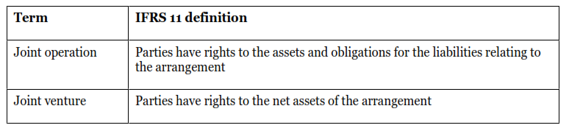
IFRS Issues in E&P Industry
Joint Arrangements
  Widely used in Oil and gas setting
  Determining the classification of joint arrangements is a four - step process as shown below:
Notes:
Joint ventures and other similar arrangements (joint arrangements) are frequently used by oil and gas companies as a way to share the higher risks and costs associated with the industry or as a way of bringing in specialist skills to a particular project. The legal basis for a joint arrangement may take various forms; establishing a joint venture might be achieved through a formal joint venture contract, or the governance arrangements set out in a company’s formation documents might provide the framework for a joint arrangement. The feature that distinguishes a joint arrangement from other forms of cooperation between parties is the presence of joint control. An arrangement without joint control is not a joint arrangement.
4.2.2 Joint control
Joint control is the contractually-agreed sharing of control over an economic activity. An identified group of venturers must unanimously agree on all key financial and operating decisions. Each of the parties that share joint control has a veto right: they can block key decisions if they do not agree.
Not all parties to the joint venture need to share joint control. Some participants may share joint control and other investors may participate in the activity but not in the joint control. Section 4.2.7 discusses the accounting for these participants.
Similarly, joint control may not be present even if an arrangement is described as a ‘joint venture’. Decisions over financial and operating decisions that are made by ‘simple majority’ rather than by unanimous consent could mean that joint control is not present.
This is a complex area which will require careful analysis of the facts and circumstances. If joint control does not exist, the arrangement would not be a joint venture. Investments with less than joint control are considered further in section 4.2.7.
A key test when identifying if joint control exists is to identify how disputes between ventures are resolved. If joint control exists, resolution of disputes will usually require eventual agreement between the venturers, independent arbitration, or dissolution of the joint venture.
One of the venturers acting as operator of the joint venture does not prevent joint control. The operator’s powers are usually limited to day-to-day operational decisions; key strategic financial and operating decisions remain with the joint venture partners collectively.
4.2.3 Classification of joint ventures
Joint arrangement’ is the term for all cooperative working arrangements where two or more parties have joint control.

Slide 52
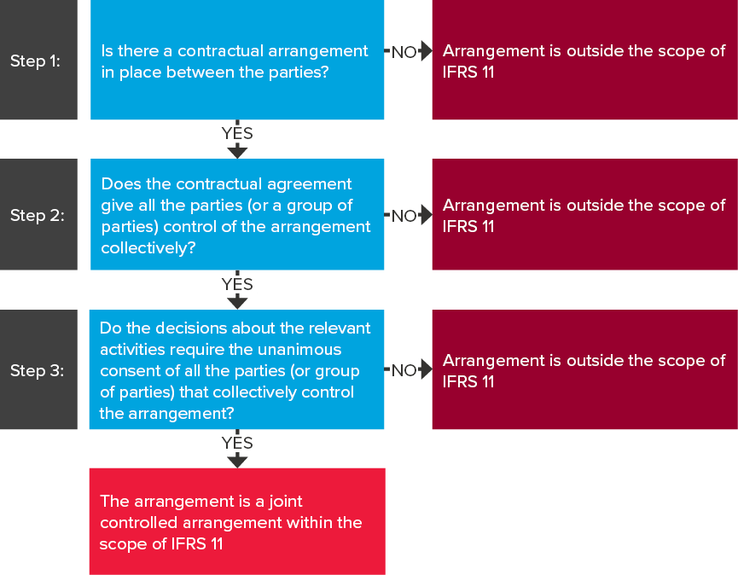
IFRS Issues in E&P Industry
How to determine if there is a joint arrangement under IFRS 11.
Notes:
Rights to assets and obligations for liabilities established by contract
The rights and obligations agreed to by the parties in their contractual terms are usually consistent with the rights and obligations conferred on the parties by the legal form of the separate vehicle
The parties may enter into contractual terms which modify or reverse the rights and obligations conferred by the legal form of the arrangement. The contractual terms have to be carefully assessed to ensure the appropriate classification of a joint arrangement.
Revenue and expenses
For example, the contractual arrangement might establish that revenues and expenses are allocated on the basis of the capacity that each party uses in a refinery or smelter operated jointly, which could differ from their ownership interest in the joint arrangement.

Slide 53
IFRS Issues in E&P Industry
Example 1
Investor A and Investor B each hold 50% of the voting rights of an investee.
The contractual arrangement between Investor A and Investor B requires at least 51% of the votes to make decisions about the relevant activities.
Investor A and Investor B have joint control over the investee because unanimous consent is required (i.e. both parties must agree) on decisions about the relevant activities.
Example 2
Investor A holds 50% of the voting rights of an investee, Investor B holds 30% and Investor C holds 20%.
The constitution of the investee requires at least 75% of the voting rights to make decisions about relevant activities of the investee. There is no contractual arrangements between any of the investors to agree to vote together on decisions about relevant activities.
In this example, none of the investors individually control the investee. Nor do any of the investors collectively have joint control because there is no contractual arrangement to act collectively. A contractual arrangement would be needed between Investors A and B to act jointly in order for there to be joint control over this investee.
Notes:
The share of assets and liabilities is not the same as proportionate consolidation. ‘Share of assets and liabilities’ means that the investor should consider their interest or obligation in each underlying asset and liability under the terms of the arrangement – it will not necessarily be the case that they have a single, standard percentage interest in all assets and liabilities.

Slide 54
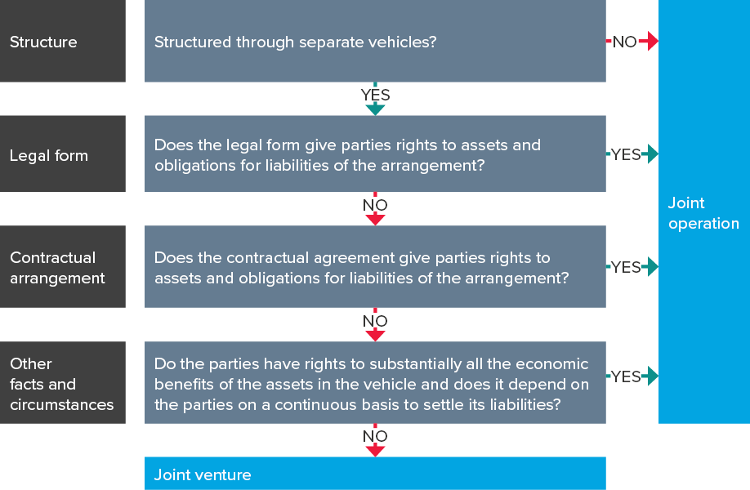
IFRS Issues in E&P Industry
Classification of Joint Arrangements
Notes:
A jointly controlled entity may be either a joint operation or a joint venture. The classification of the joint arrangement is based on the rights and obligations of the parties to the arrangements.
Separate Vehicles
The first step in determining the classification is to assess whether the arrangement is structured through a separate vehicle. A separate vehicle is a separately identifiable financial structure, including separate legal entities or entities recognised by statute, regardless of whether those entities have a legal personality.
The definition of a ‘separate vehicle’ is quite broad. It does not necessarily need to have a legal personality. Separate vehicles are generally separately identifiable financial structures having separately identifiable assets, liabilities, revenues, expenses, financial arrangements, financial records etc.
Local laws and regulations also need consideration before determining whether a particular structure meets the definition of a ‘separate vehicle’.
Joint arrangements not structured through a separate vehicle
An arrangement that is not structured through a separate vehicle is a joint operation. The parties determine in such contractual arrangements their rights to the assets, and their obligations for the liabilities, relating to the arrangement. These are classified as joint operations. Oil and gas joint working arrangements often do not operate through separate vehicles and so are classified as joint operations.
Joint arrangements structured through a separate vehicle
joint arrangement that is structured through a separate vehicle can be either a joint venture or a
joint operation depending on the parties’ rights and obligations relating to the arrangement.
The parties need to assess whether the legal form of the separate vehicle, the terms of the contractual
arrangement and, when relevant, any other facts and circumstances give them:
a) rights to the assets and obligations for the liabilities relating to the arrangement (i.e. joint operations or
b) rights to net assets of the arrangement (i.e. joint venture).
Rights to assets and obligations for liabilities conferred by legal form
The second step in determining the classification of a joint arrangement is to assess the rights and
obligations arising from the legal form of the separate vehicle.
If the legal structure of the arrangement is such that the parties have rights to assets and are
obligated for the liabilities of the arrangement, then it is a joint operation. The local laws and
regulations need to be carefully assessed in order to ascertain this.
The key question is whether the separate vehicle be considered in its own right i.e. are the assets and
liabilities held in the separate vehicle those of the separate vehicle or are they the assets and liabilities
of the parties?

Slide 55
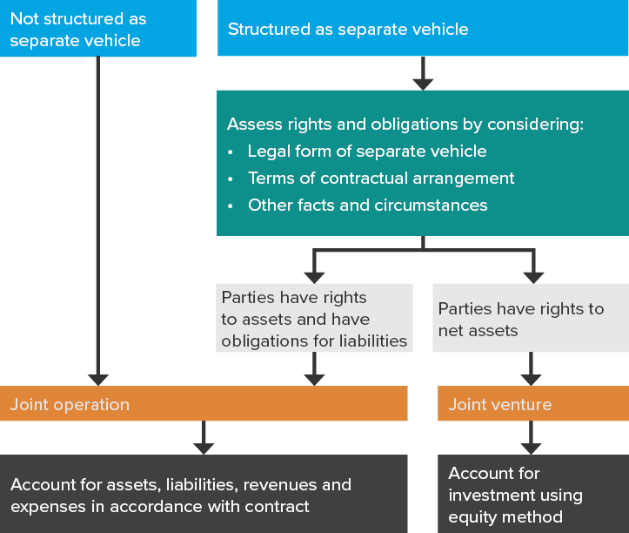
IFRS Issues in E&P Industry
Accounting for Joint Arrangements
(IAS 28, IFRS 9 & 11)
Notes:
A jointly controlled entity may be either a joint operation or a joint venture. The classification of the joint arrangement is based on the rights and obligations of the parties to the arrangements.
Separate Vehicles
The first step in determining the classification is to assess whether the arrangement is structured through a separate vehicle. A separate vehicle is a separately identifiable financial structure, including separate legal entities or entities recognised by statute, regardless of whether those entities have a legal personality.
The definition of a ‘separate vehicle’ is quite broad. It does not necessarily need to have a legal personality. Separate vehicles are generally separately identifiable financial structures having separately identifiable assets, liabilities, revenues, expenses, financial arrangements, financial records etc.
Local laws and regulations also need consideration before determining whether a particular structure meets the definition of a ‘separate vehicle’.
Joint arrangements not structured through a separate vehicle
An arrangement that is not structured through a separate vehicle is a joint operation. The parties determine in such contractual arrangements their rights to the assets, and their obligations for the liabilities, relating to the arrangement. These are classified as joint operations. Oil and gas joint working arrangements often do not operate through separate vehicles and so are classified as joint operations.
Joint arrangements structured through a separate vehicle
joint arrangement that is structured through a separate vehicle can be either a joint venture or a
joint operation depending on the parties’ rights and obligations relating to the arrangement.
The parties need to assess whether the legal form of the separate vehicle, the terms of the contractual
arrangement and, when relevant, any other facts and circumstances give them:
a) rights to the assets and obligations for the liabilities relating to the arrangement (i.e. joint operations or
b) rights to net assets of the arrangement (i.e. joint venture).
Rights to assets and obligations for liabilities conferred by legal form
The second step in determining the classification of a joint arrangement is to assess the rights and
obligations arising from the legal form of the separate vehicle.
If the legal structure of the arrangement is such that the parties have rights to assets and are
obligated for the liabilities of the arrangement, then it is a joint operation. The local laws and
regulations need to be carefully assessed in order to ascertain this.
The key question is whether the separate vehicle be considered in its own right i.e. are the assets and
liabilities held in the separate vehicle those of the separate vehicle or are they the assets and liabilities
of the parties?

Slide 56
60 Minutes
IFRS Issues in E&P Industry
We’ll resume our meeting in:

Slide 57
IFRS Issues in E&P Industry
–
102
Foreign Currency Gains and Losses (!AS 21, 23)
Facilitator
Terkimbi
Time
5 minutes

Slide 58
IFRS Issues in E&P Industry
Foreign Currency Gains and Losses
  Two possible methods are:
  The portion of the foreign exchange movement to capitalise may be estimated based on forward currency rates at the inception of the loan.
  The portion of the foreign currency movement to capitalise may be estimated based on interest rates on similar borrowings in the entity’s functional currency.
  Management must use judgement to assess which foreign exchange differences can be capitalised.
  The method used is a policy choice which should be applied consistently to foreign exchange differences whether they are gains or losses.
Notes:
When development is funded by borrowings in a foreign currency, IAS 21 The effects of changes in foreign exchange rates requires any foreign exchange gain or loss to be recognised in the income statement unless they are regarded as adjustments to interest costs, in which case they can be treated as borrowing costs in accordance with IAS 23.
The gains and losses that are an adjustment to interest costs include the interest rate differential between borrowing costs that would be incurred if the entity borrowed funds in its functional currency and borrowing costs actually incurred on foreign currency borrowings.

Slide 59
IFRS Issues in E&P Industry
–
Decommissioning (Assets Retirement Obligations)
102
Facilitator
Terkimbi
Time
5 minutes

Slide 60
IFRS Issues in E&P Industry
Decommissioning – IAS 37
  An entity that promises to remediate damage or has done so in the past, even when there is no legal requirement, may have created a constructive obligation and thus a liability under IFRS
Decommissioning provisions
  A provision is recognised when an obligation exists to perform the clean-up].
  Legal regulations should be taken into account when determining the existence and extent of the obligation.
  Obligations to decommission or remove an asset are created at the time the asset is put in place.
  Some diversity in practice as to whether the entire expected liability is recognised when activity begins, or whether it is recognised in increments as the development activity progresses.
  also diversity in whether decommissioning liabilities are recognised during the exploration phase of a project.
  The asset and liability recognised at any particular point in time needs to reflect the specific facts and circumstances of the project and the entity’s obligations.
Notes:
The oil and gas industry can have a significant impact on the environment. Decommissioning or
environmental restoration work at the end of the useful life of a plant or other installation may be
required by law, the terms of operating licences or an entity’s stated policy and past practice.
An entity that promises to remediate damage or has done so in the past, even when there is no legal
requirement, may have created a constructive obligation and thus a liability under IFRS. There may
also be environmental clean-up obligations for contamination of land that arise during the operating
life of an installation. The associated costs of remediation/restoration can be significant. The
accounting treatment for decommissioning costs is therefore critical.
A provision is recognised when an obligation exists to perform the clean-up [IAS 37 para 14]. The
local legal regulations should be taken into account when determining the existence and extent of the
obligation. Obligations to decommission or remove an asset are created at the time the asset is put in
place. An offshore drilling platform, for example, must be removed at the end of its useful life. The
obligation to remove it arises from its placement. However, there is some diversity in practice as to
whether the entire expected liability is recognised when activity begins, or whether it is recognised in
increments as the development activity progresses. There is also diversity in whether
decommissioning liabilities are recognised during the exploration phase of a project. The asset and
liability recognised at any particular point in time needs to reflect the specific facts and circumstances
of the project and the entity’s obligations.
Decommissioning provisions are measured at the present value of the expected future cash flows that
will be required to perform the decommissioning [IAS 37 para 45]. The obligation does not change in
substance if the platform produces 10,000 barrels or 1,000,000.
The cost of the provision is recognised as part of the cost of the asset when it is put in place and
depreciated over the asset’s useful life [IAS 16 para 16(c)]. The total cost of the fixed asset, including
the cost of decommissioning, is depreciated on the basis that best reflects the consumption of the
economic benefits of the asset (typically UOP). Provisions for decommissioning and restoration are
recognised even if the decommissioning is not expected to be performed for a long time, for example
80 to 100 years.
The effect of the time to expected decommissioning will be reflected in the discounting of the
provision. The discount rate used is the pre-tax rate that reflects current market assessments of the
time value of money. Entities also need to reflect the specific risks associated with the
decommissioning liability. Different decommissioning obligations will, naturally, have different
inherent risks, for example different uncertainties associated with the methods, the costs and the
timing of decommissioning. The risks specific to the liability can be reflected either in the pre-tax
cash flow forecasts prepared or in the discount rate used. The future cash flows expected to be
incurred in performing the decommissioning may be denominated in a foreign currency. When this is
relevant the foreign currency future cash flows should be discounted at a rate relevant for that
currency. The present value is translated into the entity’s functional currency using the exchange rate
at the balance sheet date.

Slide 61
IFRS Issues in E&P Industry
–
Specialised Arrangements
        Production Sharing Agreements
        Farm Outs
        Unitisation
102
Facilitator
Terkimbi
Time
30 minutes

Slide 62
IFRS Issues in E&P Industry
–
Production Sharing Arrangements
102
Facilitator
Terkimbi
Time
20 minutes

Slide 63
Definition of PSC Specific Terms
IFRS Issues in E&P Industry
S/N | Item | Description
1 | Cost recovery/ Cost oil | Mechanism within the PSC that allows contractor to recover cost (exploration, development, production) out of gross revenues Calculated as a % of gross revenues or % of net revenues (if there is a royalty)
2 | Cost recovery ceiling/ Cost oil ceiling | Limit to the amount of revenues contractor may claim for cost recovery in a particular period Some PSCs have no limit but typically range from 30% - 60%
3 | Excess cost oil | Total actual cost < Cost oil ceiling E.g. Cost oil ceiling = 100 Actual = 60 Excess cost oil = 40

Slide 64
Definition of PSC Specific Terms
IFRS Issues in E&P Industry
S/N | Item | Description
4 | Cost carry forward | Total actual cost > Cost oil ceiling Unrecovered cost may be carried forward to the next period for recovery
5 | Profit oil | Remaining production or revenues after royalty and cost recovery
6 | Entitlement | Shares of production, contractor and the government are authorised to lift
7 | Contractor PSC entitlement | Cost Oil + Share in Profit Oil
8 | Government PSC entitlement | Royalties + Share in Profit Oil + Taxes

Slide 65
Determinants of Cost Oil
IFRS Issues in E&P Industry
Cost Recovery subject to PSC Terms & Conditions:
Non recoverable vs. Recoverable
Immediate vs. Delayed
Sharing of Excess Cost Oil
Cost Ceiling (High vs. Low)
Cost Carry Forward
Uplifts or Investment Credits incentive
Ring-fencing
Cross cost recovery
Hydrocarbon measurement and valuation
Declaration of economic commerciality (by whom?)
Government Participation

Slide 66
Determinants of Entitlement Volumes
IFRS Issues in E&P Industry
  Specific PSC terms
  Production Levels
  Expenditure Levels
  Hydrocarbon Price
  Cost Recovery Position
Notes:
Issue is particularly critical with progressive regimes where government take is based more on profitability than gross revenues.
If a marginal field is developed under a progressive regime (being high cost recovery limits and low royalties) then the government share of revenues could be both small and substantially delayed.
Systems with significant limits on the contractor’s access to gross revenues have little need for a commerciality requirement.

Slide 67
Varieties Profit Sharing
IFRS Issues in E&P Industry
Sharing of Profit Oil: Balance of Risk and Reward
Fixed percentage split
Sliding Scale
R-factor
Fixed Percentage Split
  fixed and not linked to any variable element, e.g., production
  Example: 60% / 40% (Philippines PSC) or
    71.1574% / 28.8462% (Indonesia PSC)

Slide 68
Varieties Profit Sharing
IFRS Issues in E&P Industry
Sliding Scale Percentage Split
  Seen as a flexible system
  Most trigger on production rates. As production rates increase, government take increases.
  As a rule, it is better for both parties when government take is a function of profitability.
  Other factors influence profitability other than production rates such as price, expenditures, timing.
Example : Sliding Scale Percentage Split
Average BOPD | Govt, % | Contractor, %
Up to 10,000 | 30 | 70
10,001 – 20,000 | 40 | 60
20,000 + | 50 | 50
Notes:
Contract may subject other contract elements (cost recovery, royalty) to a sliding scale system
Production levels in sliding scale systems must be chosen carefully. If rates are too high, then the system effectively does not have a flexible sliding scale.
Choice of production levels is normally dictated by the anticipated size of discovery.

Slide 69
Varieties Profit Sharing
IFRS Issues in E&P Industry
R-factor
  Government take increases as project profitability increases or as contractor’s risk decreases
  Linked to a more direct measure of profitability e.g. Rate of Return, Return on Investment
  Takes into account product prices, costs, timing, and production rates
  Encourages development of marginal fields and risky projects
  Aim should be to balance risk and reward throughout production.

Slide 70
Varieties Profit Sharing
IFRS Issues in E&P Industry
Example : based on Return on Investment
  R factor = Cumulative Net Revenues / Cumulative Expenditures
  Cumulative net revenue = cumulative gross revenues received – taxes paid
  Cumulative expenditures = cumulative exploration, appraisal, and operating costs incurred from date contract is signed
R Factor | Contractor’s Profit Oil, % | Govt Profit Oil, %
R > = 0.00 | 80 | 20
R > = 1.00 | 75 | 25
R > = 1.25 | 70 | 30
R > = 1.50 | 60 | 40
R > = 2.00 | 40 | 60
R > = 2.50 | 20 | 80

Slide 71
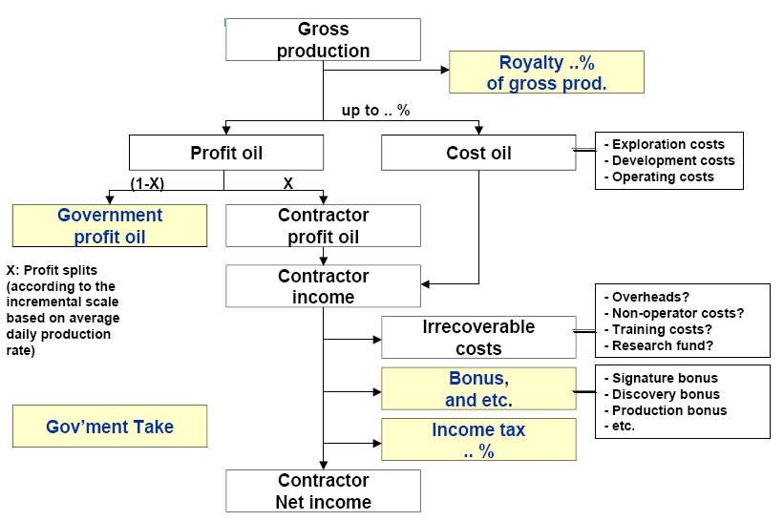
Production Sharing
IFRS Issues in E&P Industry

Slide 72
Revenue Distribution
IFRS Issues in E&P Industry
Cash To Government
Cost recovery
Example of PSA with Tax, based on Nigeria Deepwater PSC
Profit To Contractor
Revenue = Oil Price x Production
Royalty Tax
Production Bonuses
Recover Non Capital Costs (Opex)
Assessable Profit
Recover Depreciation (Capex) over 5 years
Chargeable Profit
Petroleum Profit Tax - Investment Tax Credit
(50 % of Chargeable Profit)
(50 % of Capital Expenditure)
Divisible Profit
Profit Share Government
Profit Share Contractor
Partners Profit
Shell Profit

Slide 73
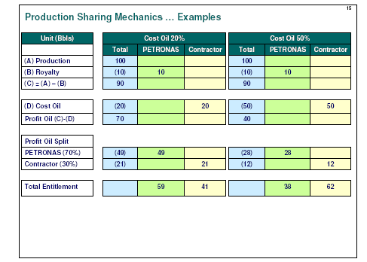
PSC Mechanics: Example
IFRS Issues in E&P Industry

Slide 74
IFRS Issues in E&P Industry
  Practical challenges with PSCs
    The legal form of the PSA or concession should not impact the principles underpinning the recognition of exploration and evaluation (E&E) assets or production assets.
    Costs that meet the criteria of IFRS 6, IAS 38 or IAS 16 should be recognised in accordance with the usual accounting policies where the entity is exposed to the majority of the economic risks and has access to the probable future economic benefits of the assets.
  i) Entity bears the exploration risk
  Cost capitalization
    Capitalise expenditure in the exploration and development phase in accordance with the requirements of IFRS 6, IAS 16 and IAS 38.
    The reserves used for depreciating the constructed assets should be those attributable to the reporting entity for the period of the PSA or concession.
    The probable hydrocarbon resources and current prices should provide evidence that E&E, development and fixed asset investment will be recovered during the concession period.
    A PSA is a separate CGU for impairment testing purposes once in production.
    Impairment testing is IFRS 6 for E&E phase and IAS 36 for Development & Production phases
Notes:
A PSA is the method whereby governments facilitate the exploitation of their country’s hydrocarbon resources by taking advantage of the expertise of a commercial oil and gas entity. Governments try to provide a stable regulatory and tax regime to create sufficient certainty for commercial entities to invest in an expensive and long-lived development process. There are as many forms of PSA and royalty agreements as there are combinations of national, regional and municipal governments in oil producing areas.
An oil and gas entity in a typical PSA will undertake exploration, supply the capital, develop the resources found, build the infrastructure and lift the natural resources. The oil and gas entity (usually referred to as the operator) will have the right to extract resources over a specified period of time; this is typically the full production life of the field such that there would be minimal residual value of the asset at the end of the PSA. The terms of the PSA are likely to include asset decommissioning requirements. The oil and gas entity will be entitled to a share of the oil produced which will allow the recovery of specified costs (‘Cost oil’) plus an agreed profit margin (‘Profit oil’). The government will retain title to all of the hydrocarbon resources and often the legal title to all fixed assets constructed
to exploit the resources. he residual value of the fixed assets in most cases would be minimal and the operator would decommission them under the terms of the PSA. The company is viewed as having acquired the right to extract the oil in the future when it performs the development work under the PSA. The development expenditure is capitalised according to the requirements of IFRS 6 and IAS 16.
The government will take a substantial proportion of the output in PSAs. The oil may be delivered in product or paid in cash under an agreed pricing formula.
An entity should consider its overall risk profile in determining whether it has a service agreement or a working interest. Certain PSAs may be more like service arrangements whereby the government compensates the entity for exploration, development and construction activities. These are arrangements where the PSA is substantially shorter than the expected useful life of the production asset or are explicit cost plus arrangements. The entity thus bears the risks of performing this
contract rather than traditional exploration and development risks. Expenditure incurred on the exploration and development plus a profit margin is usually capitalised as a receivable from the government rather than an interest in the future production of the field.
A concession or royalty agreement is much the same as a PSA arrangement where the entity bears the exploration risk. The entity will usually retain legal title to its assets and does not directly share production with the government. The government will still be compensated based on production quantities and prices – this is often described as a concession rent, royalty or a tax. PSAs and concession agreements are not standard even within the same legal jurisdiction. The more significant a new field is expected to be, the more likely that the relevant government will write specific legislation or regulations for it. Each PSA must be evaluated and accounted for in accordance with the substance of the arrangement. The entity’s previous experience of dealing with the relevant government will also be important, as it is not uncommon for governments to force changes in PSAs or royalty agreements based on changes in market conditions or environmental factors.
The PSA may contain a right of renewal with no significant incremental cost. The government may have a policy or practice with regard to renewal. These should be considered when estimating the life of the agreement.
The entity tests for impairment during the exploration and evaluation phase using the guidance in IFRS 6. Once in the development and production phases the guidance in IAS 36 applies.

Slide 75
IFRS Issues in E&P Industry
  Practical challenges with PSCs
  Offshore Field PSA for 25 years
  The legal form of the PSA should not impact the recognition of exploration and evaluation (E&E) assets or production assets. How should those assets be accounted for?
  Background
  Entity A is party to a PSA related to an offshore field. The term of the agreement is 25 years. Entity A will operate the assets during the term of the PSA but the government retains title to the assets constructed. A is entitled to full cost recovery. However, if the resources produced in the future do not cover the costs incurred, the government will not reimburse A.
  Entity A’s management proposes to account for the expenditure as a financial receivable rather than as property, plant and equipment because the government is retaining the title of the assets constructed. Is this appropriate?

Slide 76
IFRS Issues in E&P Industry
  Practical Challenges with PSCs
  Solution - Offshore Field PSA for 25 years
  No.
  Entity A controls the assets during the life of the PSA through its right to operate them. The construction costs that meet the recognition criteria of IFRS 6, IAS 38 or IAS 16 should be recognised in accordance with those standards:where the entity is exposed to the majority of the economic risks and has access to the probable future economic benefits of the assets; and the period of the PSA is longer than the expected useful life of the majority of the constructed assets; and the probable mineral resources at current prices provide evidence that E&E, development and fixed asset investment will be recovered through the cost recovery regime of the PSA.
  All assets recognised are then accounted for under entity A’s usual policies for subsequent measurement, depreciation, amortisation, impairment testing and de-recognition. The assets should be fully depreciated or amortised on a units-of-production basis by the date that the PSA ends.

Slide 77
IFRS Issues in E&P Industry
  Practical Challenges with PSCs
  Revenue Recognition
    In PSAs where an entity bears the exploration risk, it will record its share of oil or gas as revenue (both cost oil and profit oil) only when the oil or gas is produced and sold.
    The entity records revenue only when oil production commences and only to the extent of the oil to which it is entitled and sells. Oil extracted on behalf of a government is not revenue or a production cost. The entity acts as the government’s agent to extract and deliver the oil or sell the oil and remit the proceeds.
    An entity follows the same approach to revenue recognition for royalty agreements

Slide 78
IFRS Issues in E&P Industry
  Practical Challenges with PSCs
  Background
  The upstream company (or contractor) typically bears all the costs and risks during the exploration phase. The government (or the government-owned oil company) shares in any production. The upstream company generally receives two components of revenue; cost oil and profit oil. Cost oil is a ‘reimbursement’ for the costs incurred in the exploration phase and some (or all) of the costs incurred during the development and production phase. Profit oil is the company’s share of oil after cost recovery or as a result of applying a profit factor
  The PSA typically specifies, among other items, which costs are recoverable, the order of recoverability, any limits on recoverability, and whether costs not recovered in one period can be carried forward into a future period. Total revenue of the PSA is recognised upon the delivery of the volumes produced to a third party (i.e. the purchaser of the volumes) based on the price as set forth in the PSA. The price could be either a market-based price or a fixed price depending on the specific terms of the PSA. The revenue of the PSA is then split between the parties based on the specific sharing terms of the PSA. The formation of a PSA does not commonly create an entity that would qualify as a joint venture under IFRS.
  The issue is not usually recognition of revenue – the oil has been delivered to third parties and the criteria in IAS 18 paragraph 14 are met. The question is how the revenue from oil sold should be split between the operator, the government oil company and any others.
Notes:
Solution
The operator is entitled to the oil it has earned as reimbursement for costs (exploration and its share of development and production) and its share of profit oil. The government’s share of oil does not form part of revenue even if the operator collects the funds and remits them to the government oil company. Any royalties or excise taxes that are collected on behalf of the government or any other agency of the state do not form revenue of the operator because of the explicit guidance in IAS 18 paragraph 8.

Slide 79
IFRS Issues in E&P Industry
  Practical Challenges with PSCs
  Background
  The upstream company (or contractor) typically bears all the costs and risks during the exploration phase. The government (or the government-owned oil company) shares in any production. The upstream company generally receives two components of revenue; cost oil and profit oil. Cost oil is a ‘reimbursement’ for the costs incurred in the exploration phase and some (or all) of the costs incurred during the development and production phase. Profit oil is the company’s share of oil after cost recovery or as a result of applying a profit factor
  The PSA typically specifies, among other items, which costs are recoverable, the order of recoverability, any limits on recoverability, and whether costs not recovered in one period can be carried forward into a future period. Total revenue of the PSA is recognised upon the delivery of the volumes produced to a third party (i.e. the purchaser of the volumes) based on the price as set forth in the PSA. The price could be either a market-based price or a fixed price depending on the specific terms of the PSA. The revenue of the PSA is then split between the parties based on the specific sharing terms of the PSA. The formation of a PSA does not commonly create an entity that would qualify as a joint venture under IFRS.
Notes:
Solution
The operator is entitled to the oil it has earned as reimbursement for costs (exploration and its share of development and production) and its share of profit oil. The government’s share of oil does not form part of revenue even if the operator collects the funds and remits them to the government oil company. Any royalties or excise taxes that are collected on behalf of the government or any other agency of the state do not form revenue of the operator because of the explicit guidance in IAS 18 paragraph 8.

Slide 80
IFRS Issues in E&P Industry
  Practical Challenges with PSCs
  Solution
  The operator is entitled to the oil it has earned as reimbursement for costs (exploration and its share of development and production) and its share of profit oil. The government’s share of oil does not form part of revenue even if the operator collects the funds and remits them to the government oil company. Any royalties or excise taxes that are collected on behalf of the government or any other agency of the state do not form revenue of the operator because of the explicit guidance in IAS 18 paragraph 8.

Slide 81
IFRS Issues in E&P Industry
Entity bears the Contractual Performance Risk
  Cost capitalization
Capitalise E&E and development costs,
Costs of constructing the fixed assets are capitalised but not classified as PPE but receivable from the government where it is allowed to retain oil extracted to the extent of costs incurred plus a profit margin in line with IAS 39/IFRS 9 rather than IAS 16.
  Impairment assessment
  Asset accounted as a receivable so impairment testing rules on financial assets in IAS 39/IFRS 9 would be applicable.
  Revenue recognition
  If the entity bears the risks of performing the contract rather than the actual exploration activity, expenditure incurred on the exploration and development of the asset is capitalised as a receivable from the government rather than as a fixed asset. When the outcome of the contract can be reliably estimated, the percentage of completion method will be used to determine the amount of revenue to be recognised. The expected profit margin will be included in this calculation.

Slide 82
IFRS Issues in E&P Industry
  Background
  Government ‘V’ believes they might find oil reserves on the western coast of the country, designated ‘Beta’. After the process, entity ‘A’ was awarded with the offshore block. The government and company A signed a 15-year PSA to explore, develop and exploit this block under the following terms:
    Company ‘A’ will undertake exploration, development and production activities.
    Government ‘V’ will remunerate A for performance of the contracted construction services regardless of the success of the exploration and hold title to the assets constructed.
    National law indicates that the title of all hydrocarbons found in the country remains with government ‘V’.
    Government ‘V’ will reimburse for all expenditures incurred by company ‘A’ at the following milestones: - Completion of seismic study programme
      Approval of exploration work programme
      Completion of development work programme
      Commencement of commercial production
Entity bears the Contractual Performance Risk

Slide 83
IFRS Issues in E&P Industry
Entity bears the contractual performance risk
  Background
    Reimbursement is based on approved costs incurred plus an uplift of 5%.
    Reimbursement will be performed in the form of oil produced. Quantities provided will be based on market price. Where insufficient quantities are produced, the government can settle the amount due in cash or oil from another source.
  How will entity ‘A’ recognise revenue on this project?

Slide 84
IFRS Issues in E&P Industry
Entity bears the contractual performance risk
  Solution
  The terms of the agreement are such that company A carries a ‘contract performance’ risk rather than bearing the risk of exploration. Accordingly, costs will be capitalised as a recoverable from the government. There are multiple performance obligations within the agreement, and the company can only recognise revenue as each of these obligations is achieved. As the terms provide that approved costs can be recovered with a 5% uplift, the company will initially carry the costs incurred as work in progress. When the entity is able to reliably estimate the outcome of the contract, it may use the percentage of completion method to recognise revenue, which will include the expected uplift of 5% on costs incurred.

Slide 85
IFRS Issues in E&P Industry
–
102
Farm-Outs
Facilitator
Terkimbi
Time
5 minutes

Slide 86
IFRS Issues in E&P Industry
Accounting by the farmor
Assets with proven reserves
  Farm-in accounted for in accordance with the principles of IAS 16. The farm out will be viewed as an economic event, as the farmor has relinquished its interest in part of the asset in return for the farmee delivering a developed asset in the future.
  Rights and obligations of parties need to be understood while determining the accounting treatment.
  The consideration received by the farmor in exchange for the disposal of their interest is the value of the work performed by the farmee plus any cash received. This is presumed to represent the fair value of the interest disposed of in an arm’s length transaction.
Assets with no proven reserves
  Asset still subject to IFRS 6 Exploration for and evaluation of mineral resources rather than IAS 16.
  The reliable measurement test in IAS 16 for non-cash exchanges may not be met.
  Neither IFRS 6 nor IFRS 11 gives specific guidance on the appropriate accounting for farm outs.
Notes:
A ‘farm out’ occurs when a venturer (the ‘farmor’) assigns an interest in the reserves and future production of a field to another party (the ‘farmee’). This is often in exchange for an agreement by the farmee to pay for both its own share of the future development costs and those of the farmor. There may also be a cash payment made by the farmee to the farmor. This is a “farm in” when considered from the farmee’s perspective. This typically occurs during the exploration or development stage and is a common method entities use to share the cost and risk of developing properties. The farmee hopes that their share of future production will generate sufficient revenue to compensate them for performing the exploration or development activity.
Assets with proven reserves
The farmor should de-recognise the carrying value of the asset attributable to the proportion given up, and then recognise the ‘new’ asset to be received at the expected value of the work to be performed by the farmee. After also recording any cash received as part of the transaction, a gain or loss is recognised in the income statement. The asset to be received is normally recognised as an intangible asset or ‘other receivable’. When the asset is constructed, it is transferred to property, plant and equipment.
Assessing the value of the asset to be received may be difficult, given the unique nature of each development. Most farm out agreements will specify the expected level of expenditure to be incurred on the project (based on the overall budget approved by all participants in the field development). The agreement may contain a cap on the level of expenditure the farmee will actually incur. The value recognised for the asset will often be based on this budget. A consequence is that the value of the asset will be subject to change as the actual expenditure is incurred, with the resulting adjustments affecting the gain or loss previously recognised. The stage of development of the asset and the reliability of budgeting will impact the volatility of subsequent accounting.

Slide 87
IFRS Issues in E&P Industry
Farm-Outs
Accounting by the farmee
  The farmee will only recognise costs as incurred, regardless of the stage of development of the asset.
  The farmee is required to disclose its contractual obligations to construct the asset and meet the farmor’s share of costs.
  The farmee should follow its normal accounting policies for capitalisation, and also apply them to those costs incurred to build the farmor’s share.
Notes:
Several approaches have developed in practice by farmors for accounting for assets with no proven reserves
recognise only any cash payments received and do not recognise any consideration in respect of the value of the work to be performed by the farmee and instead carry the remaining interest at the previous cost of the full interest reduced by the amount of any cash consideration received for entering the agreement. The effect will be that there is no gain recognised on the disposal unless the cash consideration received exceeds the carrying value of the entire asset held;
follow an approach similar to that for assets with proven reserves, recognising both cash payments received and value of future asset to be received, but only recognise the future asset when it is completed and put into operation, deferring gain recognition until that point; or
follow an approach similar to that for assets with proven resources, recognising both cash payments received and value of future asset to be received, and recognise future asset receivable when the agreement is signed with an accompanying gain in the income statement for the portion of reserves disposed of.
All three approaches are used today under current IFRS. There can be volatility associated with determining the value of the asset to be received as consideration for a disposal in a farm out of assets with proven resources. This volatility is exacerbated for assets which are still in the exploration phase. Prevalent industry practice follows the first approach outlined above.

Slide 88
IFRS Issues in E&P Industry
–
Unitisation
102
Facilitator
Terkimbi
Time
5 minutes

Slide 89
IFRS Issues in E&P Industry
Unitisation agreements
  share of output allocated to each participant will depend on the contribution their existing asset made to the total production of this area. This is known as a ‘unitization
  preliminary assessment of the allocated interest is made on the initial unitisation and the entity will be responsible for future expenditure for the area in accordance with its allocated interest.
  interest subsequently amended as more certainty is obtained and redeterminations are made.
  Adjustments to future production entitlement or cost contributions may be made accordingly
  Cash payments may be made between the participants where there is insufficient production or development remaining to true up contributions to date.
  The initial unitisation is accounted for as a contribution of assets. No change is recorded in the carrying amount of existing interests unless cash payments have been made on unitization
  The unitisations and redeterminations will also affect the relevant reserves base to be used for the purposes of the DD&A calculation
Notes:
Usually occurs in the exploration or development stage of O&G assets
Entities may own assets or exploration rights in adjacent areas and enter into a contract to combine these into a larger area and share the costs of exploration, development and extraction. The entity will receive in exchange a share of the expected future output of the larger area.
The interest will be subsequently amended as more certainty is obtained over the final output of each component and redeterminations are made. Adjustments to future production entitlement or cost contributions may be made accordingly. Cash payments may be made between the participants where there is insufficient production or development remaining to true up contributions to date.

Slide 90
15 Minutes
Accounting & Auditing Issues in JVs
We’ll resume our meeting in:

Slide 91
Section 3
Accounting & Auditing Issues in Joint Ventures
  Understanding JOA/{PSC Governance
  The Cash Call process & Accounting
  The JV Fundamentals
  The Billing Statements
  JV Reporting (of Expenditures)
  Non-Operators’ Audit Rights
  The Cost Allocation Process

Slide 92
–
Accounting & Auditing Issues in JVs
    Understanding JOA/PSC Governance
102
Facilitator
Terkimbi
Time
40 minutes
Understanding JOA Governance
Understanding PSC Governance

Slide 93
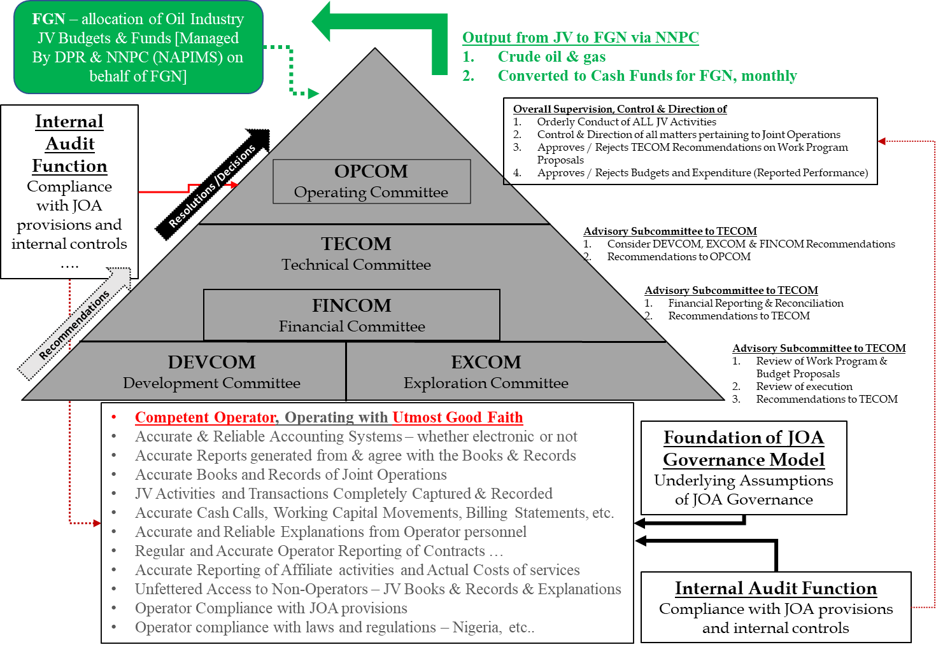
Understanding JOA Governance
Accounting & Auditing Issues in JVs

Slide 94
Understanding JOA Governance
Accounting & Auditing Issues in JVs
SN | Key Responsibilities of the OPERATOR as enshrined in the JOA Governance Model
1 | Management, Commercial, Technical & Financial Competence
2 | Demonstrate Utmost Good Faith in all actions
3 | Prepare & get Approval for Annual Work Programme & Budgets
4 | Prepare & get Approval for Budget Revisions & Amendments
5 | Approvals of key Operations Decisions
6 | Seek & Receive Tender Approvals > thresholds
7 | Enter Contracts within thresholds
8 | Seek Non-Operator Concurrence on Purchases
9 | Run Operations in a Workmanlike manner
10 | Produce hydrocarbons and comply with Regulations
11 | Arrange hydrocarbons off-taking arrangements for all JV Partners
12 | Keep Accurate Books and records
13 | Provide Accurate Information of Joint Operations
14 | Conform with Industry Standards & Best Practices
15 | Prepare and present Monthly & Annual Performance Report
16 | Prepare and present Monthly & Annual Returns
17 | Make Monthly Cash Calls of JV Partners
18 | Provide Unfettered Access to Books & Non Operators
19 | Provide Unfettered Access to Information to Non Operators
20 | Responsiveness to Non Operator enquiries at all times

Slide 95
Understanding JOA Governance
Accounting & Auditing Issues in JVs
Key Points to Note about JOA Governance Model
OPCOM + Approval Framework: provides assurance on Operator technical competence & accountability
Internal Audit Function – Compliance & Assurance
Foundation of JOA Governance Model – based on assumptions key of which are that the Operator:
  Is Competent Operator [technically, commercially & administratively)
  Will operate with Utmost Good Faith
  Complies with oversight processes and procedures in JOA
  Holds itself accountable to Non-Operators
  Conforms with industry best practices
  Adds value through competence – technical and administrative
  Safeguards JV investment and assets through effective risk management
  Records all activities of Joint Operations timely and accurately
  Ensures unfettered access to JV Books and Records and information to non-operators, their representatives and auditors without limitation, in conformance with the many JOA provisions on such access rights
  Facilitates Audit Rights exercise by Non-Operators

Slide 96
Understanding JOA Governance
Accounting & Auditing Issues in JVs
OPCOM + Approval Framework: provides assurance on technical competence, assurance & accountability
Internal Audit Function envisaged – Compliance & Assurance that resources will be used efficiently and processes, laws and regulations and JOA complied with. Operator is regularly evaluated! – assurance, competence
Foundation of JOA Governance
  Competent Operator, operating with Utmost Good Faith -
  Annual WP&B – plan of activities based on objectives (e.g. production growth)
  Accurate & Reliable Accounting systems – to keep Accurate Books & Records – Accounting Controls – provide assurance
  Accurate Reports – Billing Statements, Working Capital Analysis, … Reconciliations provide assurance, oversight
  Unfettered access to books and records at all times to Non-Operators – oversight and assurance to Non-Operators
  Operator compliance with JOA provisions - accountability
  Effective Internal controls – assurance,
  Effective Internal Audit function – transparency, accountability
  Effective Risk Management – competence, accountability
  All Joint Operations activities are recorded – probity, transparency, accountability and administrative competence
  Operator conforms to Industry Standards. – transparency, competence

Slide 97
Oversight
Accounting & Auditing Issues in JVs
Understanding JOA Governance
  Exercise of Rights & Obligations in Relationship
  OPCOM+ participation [effective]
  Technically Competent reviews
  Rights to block any and everything at OPCOM is the Nuclear Option; it is there to be used
  Understanding JOA provisions and own Rights
  Monthly oversight of Operator CCR, Reports & Output
  Vigilance and nit-picking on every item of non-compliance and infraction.
  Unfettered access to Books & Records is unfettered Access
  Assertive follow up on own requests of Operator
  Audit Rights are unlimited in time and scope, yet, limited in terms of discrepancies (36 months), unless fraud can be ascertained. How do a JV partner ascertain fraud when it does not have access to the books & records?
Key Non-Operator Rights in JOA
Participate in OPCOM – unanimous vote
Receive Annual WP & Budgets
Receive Cash Call Requests
Receive Defined JV Activity Reports – Monthly, Quarterly, Annually
Responsiveness from Operator on enquiries at all times
Unfettered Access to Books & records by Non-Operators
Unfettered Access to Information by Non-Operators
Unencumbered access for Non-Operators to exercise Audit Rights
1
+
2
+
3
1
These 3 rights clusters provide a good basis for effective non-operator oversight of Operator
2
4
Audit Rights trump all other rights and can be used to make claims & prep for a show down at OPCOM (decision is by unanimous vote)
3
4

Slide 98
Accounting & Auditing Issues in JVs
Understanding JOA Governance
    PSC Governance and Audit - Decision Hierarchy
JV Management
PSC MACOM
+ PSC Terms
Costs recoverable from NNPC
JOA OCM
+ JOA Terms
Costs billable to CoV
OilCo Parent
Fund Allocation
Budget Proposal

Slide 99
PSC Approval Process
Accounting & Auditing Issues in JVs
Understanding JOA Governance
Approves cost recovery
MACOM (PSC)
MACOM dry run
TCM dry run
PSC
TECOM (PSC)
TCM (JOA)
JOA
TECOM dry run
OCM dry run
Pre- TECOM
OCM (JOA)
Approves Billing to Partners

Slide 100
Accounting & Auditing Issues in JVs
Understanding JOA Governance
NAPIMS Key Role in Budget Approval and Tender Award
NAPIMS role through Management Committee
• Approves
– Work programs
– Budgets
External costs
• Approves:
– Budget for affiliate services (SDS, SGS,etc)
– Contracts to third parties > $250,000
External costs
• Approves:
– bid list (and may add or remove contractors)
– bid analysis and contract award
• Participates in:
– The prequalification of Contractors
– The bid evaluation process
• Give preference to Nigerian companies and goods if available and at a premium not exceeding 10%
Competitive bid
process
Compliance with PSC rules essential for cost recovery
7

Slide 101
Accounting & Auditing Issues in JVs
Understanding JOA Governance
Other JoA and PSC requirements EXAMPLES!
_{• Affiliate se}
rvices (Not in WP&B and over $250K?)
award
• Third
• “Project
• Over expe
party contracts (Levels A, B and C)
Cost Estimate” (AFE?)
nditure
Contract
(JoA)
award
• All
• All local c
• Basically
Contract
foreign contract/P.O. over $250K
ontracts/P.O. over N 1 MM ($8K!!!)
AFE type process for each “project” with progress report.
(PSC)
• R
etention fee on contracts
Directives and
JoA partners may agree to follow different procedures
Regulations issued by
NNPC may over-lap with
PSC
14

Slide 102
Accounting & Auditing Issues in JVs
Understanding JOA Governance
Types of Costs
Typical Billable/Recoverable costs
Exploration costs
Appraisal costs
Capital costs
Operating costs
Yearly decommissioning costs
Costs carried forward
Common issues
Redundancy/restructuring costs
Entertainment
Shareholders / Central Office Costs
Publicity / public relations costs
Donations
Expatriate-related costs
Affiliate companies’ costs
Budget overrun / unbudgeted costs
Non-compliance with contractual procedures
Inadequate audit trail
Expenditures unrelated to Petroleum Operations

Slide 103
–
Accounting & Auditing Issues in JVs
    Cash Call (Process & Accounting)
102
Facilitator
Terkimbi
Time
30 minutes
Cash Call provision under JOA 1991
Cash Call Accounting - Operator
Cash Call Accounting - Non-Operator

Slide 104
Accounting & Auditing Issues in JVs
    Cash Call (Process & Accounting)
Cash Call provision under JOA 1991
  The process outlined requires the Operator to submit to each party the items listed hereunder and apply the calculation outlined in the template:
  an itemized estimate of such costs and expenditures (Estimated Expenditures) – of the Cash Call Month, - at Article 6.2.1 (a)
  an itemized return of the actual expenditures (Total Actual Expenditures) of the month, 2 months prior to the Cash Call Month (Actual Expenditure Month) - at Article 6.2.1 (a)
  an itemization of the Cash Available or the Cash Deficit in the Joint Bank Account as the case may be - at Article 6.2.1 (b)
  Any credit expected to be received in the Cash call Month - at Article 6.2.1 (b)
  Such Party’s Cash Call for the month, which shall be the PI share of Estimated Expenditure adjusted by the Cash or Deficits and Credits in the Article 6.2.1 (b).
  Template for Calculating the Monthly Cash Call request as outlined in Article 6.2.1(c) and supported by the analysis of the key terms in the definition of a Cash Call per Article 1.1.9 of the JOA Figure 6 below refers).

Slide 105
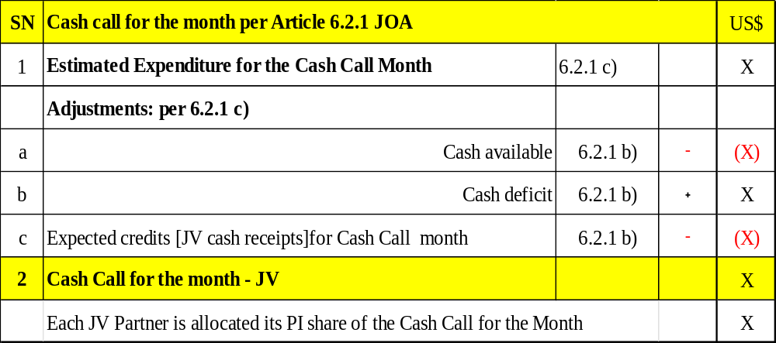
Accounting & Auditing Issues in JVs
    Cash Call (Process & Accounting)
Cash Call provision under JOA 1991
Cash Call Template under JOA 1991

Slide 106
Accounting & Auditing Issues in JVs
    Cash Call (Process & Accounting)
Cash Call provision under JOA 1991
Cash Call Accounting - Operator
A | Cash Call
1 | Dr | Cash Call Receivable
 | Cr | Cash Call - Partner Account
 | Cash Call Request from Operator - Agreed Cash call request
2 | Dr | Bank
 | Cr | Cash call Receivable
 | Recognition of the amount paid - this may be piecemeal or full amount
3 | Dr | Cash Call - Partner Account
 | Cr | Cash Call Receivable / Bank
 | Recognition of the amount over called in prior month - depending on whether the cash call was fully paid or not
4 | Dr | Cash Call Receivable / Bank
 | Cr | Cash Call - Partner Account
 | Recognition of the amount under called in prior month - depending on whether the cash call was fully paid or not

Slide 107
Accounting & Auditing Issues in JVs
    Cash Call (Process & Accounting)
Cash Call provision under JOA 1991
Cash Call Accounting - Operator
B | Billings , Returns and cutback
1 | Dr | Opex / Capex / Inventory/ Prepayments / other WC
 | Cr | Accruals / Vendors / Other payables
 | Cr | Bank / Cash
 | Recognition of Expenditure on accrual basis
2 | Dr | Customer
 | Cr | Income / JV Insurance Reimbursements
 | Recognition of the Joint income / Joint Insurance claims reimbursement on Accrual basis as Invoices and debit notes are issued
3 | Dr | Cash Call - Partner Account
 | Cr | Cut back - Opex Capex
 | Cr | Cut back - Income
 | Cr | Cut back - WC excluding cash
 | Recognition of cutback entries
1 | Dr | Asset Disposal
 | Cr | Asset WBE
 | JV Assets Written off
4 | Dr | Bank / Cash / Receivable
 | Cr | Income from Asset disposal
 | JV Assets sold

Slide 108
Accounting & Auditing Issues in JVs
    Cash Call (Process & Accounting)
Cash Call provision under JOA 1991
Cash Call Accounting - Operator
C | Governance Resolutions
1 | Dr | Opex / Capex
 | Cr | Cash Call - Partner Account
 | Being Recognition of OPCOM rejections
The Partner pays when there is cash out not at utilisation. Inventory is paid for by the partners as they are taken to store . When issues to projects it becomes an entry between inventory and capex, in which case there is no new cash call requirement on the JV partner.
Working capital adjustments and movement forms part of the adjustments that are required to establish the actual cash calls owed.

Slide 109
Accounting & Auditing Issues in JVs
    Cash Call (Process & Accounting)
Cash Call provision under JOA 1991
Cash Call Accounting – Non Operator
A | Cash Call
1 | Dr | Cash Call Made
 | Cr | Cash call Payable
 | Cash Call Request from Operator - Agreed Cash call request
2 | Dr | Cash Call Payable
 | Cr | Bank
 | Recognition of the amount paid - this may be piecemeal or full amount
3 | Dr | Cash Call Payable / Bank
 | Cr | Cash call Made
 | Recognition of the amount over called in prior month - depending on whether the cash call was fully paid or not
4 | Dr | Cash Call Made
 | Cr | Cash call Payable / Bank
 | Recognition of the amount under called in prior month - depending on whether the cash call was fully paid or not

Slide 110
Accounting & Auditing Issues in JVs
    Cash Call (Process & Accounting)
Cash Call provision under JOA 1991
Cash Call Accounting – Non Operator
B | Billings and Returns
1 | Dr | Opex / Capex
 | Cr | Cash Call Made
 | Recognition of the JV cost for the month
2 | Dr | Cash Call Made
 | Cr | Income / JV Insurance Reimbursements
 | Recognition of the Joint income / Joint Insurance claims reimbursement paid directly to the joint account managed by Operator.
3 | Dr | Cash Call Payable
 | Cr | Cash Call Made
 | Recognition of working Capital
4 | Dr | Accummulated Depreciation
 | Dr | Profit Loss on Disposal
 | Cr | PP & E
 | JV Assets Written off

Slide 111
Accounting & Auditing Issues in JVs
    Cash Call (Process & Accounting)
Cash Call provision under JOA 1991
Cash Call Accounting – Non Operator
C | Governance Resolutions
1 | Dr | Cash Call Made
 | Cr | Opex / Capex
 | Being Recognition of OPCOM rejections

Slide 112
–
Accounting & Auditing Issues in JVs
    JV Accounting Fundamentals
102
Facilitator
Terkimbi
Time
30 minutes
  Understanding the JV Ledger
  The roll up Process
  The JV Fundamental Accounting Equation (JVFAE)

Slide 113
Accounting & Auditing Issues in JVs
    JV Accounting Fundamentals
A few things to Note
Joint Venture Relationship with Cost Objects
All cost objects (cost centres, WBS elements and Works Mgt (WM) orders) hold joint
venture data, which determines which JV agreement is relevant to the costs posted to that
cost object.
A WBS element will copy its joint venture information from its responsible cost centre. All
subsequent orders will copy JV data from their parent cost objects.
NB: For any cost centres to be created, the JV attributes must be specified – i.e. whether JV, Exclusive, etc
Notes:
For any cost centres to be created, the JV attributes must be specified – i.e. whether JV, NG05, EA, KH (JV with Agip, Elf except NNPC), SNEPCO,

Slide 114
Accounting & Auditing Issues in JVs
    JV Accounting Fundamentals
A few things to Note
COST CENTRE
A cost centre is an Organisational unit within a controlling area that represents a
defined location of cost incurrence
  Cost Centre Functionality
  Captures Plan & Actual Costs
  One cost center represents a unique Combination of Assets and Activity Dimensions.
  Contains JV Info (e.g.: Joint Venture, Recovery Indicator, etc).
  Represents Service Provider and is used within Cost Allocation.
  Allows Tariffing.

Slide 115

Accounting & Auditing Issues in JVs
    JV Accounting Fundamentals
A few things to Note
WBS
WBS means Work Breakdown Structure
Individual structural element in a work breakdown structure (WBS) representing the hierarchical organization of a project
A Project is structured by means of WBS Elements and Networks
WBS Elements describe specific tasks or actions in the project to be carried out within the defined time period
  WBS Main Uses:
  Captures all Costs: Plan, Actual, OPEX/CAPEX
  Settles Costs to Fixed Asset/AuC (Capex) or other cost objects (OPEX)
  Enables Bottom-Up Cost Planning and Top-Down Budgeting
  Facilitates Budget Availability Control
NB: Monthly the Billing Statements are reconciled to the TB which cans be traced to the expanse analyses.
Notes:
Monthly the Billing Stmts are reconciled to the TB which cans be traced to the expanse analyses.

Slide 116
Accounting & Auditing Issues in JVs
    JV Accounting Fundamentals
A few things to Note
WBS SUMMARY
  All capital projects.
  All OPEX projects.
  All fields/assets will capture direct costs.
  WBS is used for projects and Cost centres are used for Overheads e.g. travel costs.
  OPEX projects are costs that are neither CAPEX or Overheads but relate to the project e.g. XYY Project
Notes:
WBS is used for projects and Cost centres are used for Overheads e.g. travel costs.
OPEX projects are costs that are neither CAPEX or Overheads but relate to the project e.g. Afam

Slide 117
Cost Element / GL Accounts
Accounting & Auditing Issues in JVs
    JV Accounting Fundamentals
A few things to Note
  Primary Cost Elements
  Used to identify external sales and purchases of product, materials & services
  Related to GL accounts
Secondary Cost Elements
Used for the accounting of internally generated indirect costs.
Not linked to G/L account codes and cannot be used for direct posting of external costs

Slide 118
Accounting & Auditing Issues in JVs
    JV Accounting Fundamentals
Understanding the JV Ledger
Venture/Partner
Ledger
Payroll
Accounts Receivable
PARTNERS’ PERFORMANCE REPORT
COST LEDGER
Accounts Payable
Inventory
THROUGH ROLL-UP
PROCESS
BILLING STATEMENT
Capital Assets
GENERAL LEDGER

Slide 119
Accounting & Auditing Issues in JVs
    JV Accounting Fundamentals
Understanding the JV Ledger
VENTURE LEDGER / PARTNERS’ REPORT (ERP)
Financial Accounting
MAP
P
ING
TABLES
BUDGET/
PARTNERS’ PERFORMANCE REPORT
Plant Maintenance
Material Management
GENERAL LEDGER
Project Systems
BILLING STATEMENT
AG 5%
TF 10%
NN 55%
SC 30%
Capital Assets

Slide 120
Accounting & Auditing Issues in JVs
    JV Accounting Fundamentals
Understanding the JV Ledger
THE VENTURE LEDGER
FUNCTIONAL
SOURCE $
SOURCE NAIRA
00
General
Ledger
49
50
Cost
Ledger
99

Slide 121
Accounting & Auditing Issues in JVs
    JV Accounting Fundamentals
Understanding the JV Ledger
Source & Functional Currencies
SOURCE CURRENCIES are the
currencies in which the Venture is funded and in which the Operator effects disbursement
FUNCTIONAL CURRENCIES are the
currencies in which Partners are required
to make Financial Reports and the
Operator maintains Budgetary Control

Slide 122

Accounting & Auditing Issues in JVs
    JV Accounting Fundamentals
Understanding the JV Ledger
GENERAL LEDGER CHART OF ACCOUNTS
FUNCTIONAL
SOURCE DOLLAR
SOURCE NAIRA
01
Balance Sheet Accounts
39
40
Income & Expenditure
Accounts
49

Slide 123
Accounting & Auditing Issues in JVs
    JV Accounting Fundamentals
Understanding the JV Ledger
COST LEDGER CHART OF ACCOUNTS
ACCOUNT
COST CENTRE
50
A
D
G
S
C
E
P
Activity at Assets
Drilling Projects
Department Costs
Seismic Projects
Construction Projects
EWMS Projects
99
OPEX Projects

Slide 124
Accounting & Auditing Issues in JVs
    JV Accounting Fundamentals
The Roll Up process
The objective of the roll up process is to aggregate expenditure recorded in the Cost Ledger to a series of summary accounts in the General Ledger
GENERAL LEDGER
E
X
P
E
N
D
I
T
U
R
E
CR
Balance Sheet Accounts
Income & Expenditure
Accounts
COST LEDGER
DR
Activity Cost Centres
Reallocation Accounts

Slide 125
Accounting & Auditing Issues in JVs
    JV Accounting Fundamentals
The Roll Up process
GENERAL LEDGER
E
X
P
E
N
D
I
T
U
R
E
CR
R
O
L
L
U
P
P
R
O
C
E
S
S
Balance Sheet Accounts
Income & Expenditure
Accounts
DR
COST LEDGER
DR
Activity Cost Centres
Reallocation Accounts
CR

Slide 126

Questions

Slide 127
Thank You
Notes:
127

Slide 128
Thursday 28 July 2022
S/No | Start time | Stop time | Allotted Minutes | Activity
 | 9:00 AM | 10:30 AM | 90 | Accounting and Auditing Issues in Joint Ventures (JVs)
 | 10:30 AM | 10:45 AM | 15 | Tea Break
4 | 10:45 AM | 12:15 PM | 90 | Syndicate Session – Interpreting Billing Statements
 | 12:15 PM | 1:15 PM | 60 | LUNCH
3 | 1:15 PM | 2:15 PM | 60 | Understanding Financial Statement of Upstream Entities
 | 2.15 PM | 2.45 PM | 30 | Relevance and Reliability of Financial Reports in Audits
 | 2:45 PM | 3:00 PM | 15 | Tea Break
 | 3:00 PM | 4:30 PM | 90 | Risks & Controls and Application to Audit of Upstream Contracts
 |  |  |  | END

Slide 129
Accounting & Auditing Issues in JVs
    JV Accounting Fundamentals
  The JV Fundamental Accounting Equation (JVFAE)
Assets – Liabilities = Owners Funds
Cash + Other Assets – Liabilities = OCF + REBF + Rev – Exp
Cash + [Other Assets – Liabilities] = OCF + REBF + Rev – Exp
Working Capital “WC” = Other Assets – Liabilities [per JOA Article 1.1.37]
Cash + WC = OCF + REBF + Rev – Exp
Cash + WC – Rev + Exp = OCF +REBF, or
Exp + WC – Rev = OCF + REBF – Cash
There is no Retained Earnings Brought Forward (REBF) in a JV, and so
Exp + WC – Rev = OCF – Cash (as REBF = 0)
Exp + WC – Rev + Cash = OCF
Owners Contributed Funds (OCF) in a JV are the Contributed Cash Calls by JV partners, – the JV Partners’ Accumulated Partner Funding position (“APF”)
Rev (Revenue) for a JV, are JV receipts (i.e., non-operating JV revenue, other income and receipts, proceeds from sale of assets, insurance proceeds, etc.).
JVFAE is Exp + WC – Rev = APF – Cash also,
JVFAE is Exp + WC – Rev + Cash = APF

Slide 130
Accounting & Auditing Issues in JVs
    JV Accounting Fundamentals
  The JV Fundamental Accounting Equation (JVFAE)
Every year, whether for the year or/and at the end of the year, the Fundamental Accounting Equation for a JV will hold true. Meaning that Exp + WC – Rev + Cash = APF, where
Exp = Expenditure
WC = Working Capital
Rev = JV Rev (JV non-operating revenues, receipts, incomes, etc..)
Cash = Cash Position
APF = Accumulated (JV) Partner Funding

Slide 131
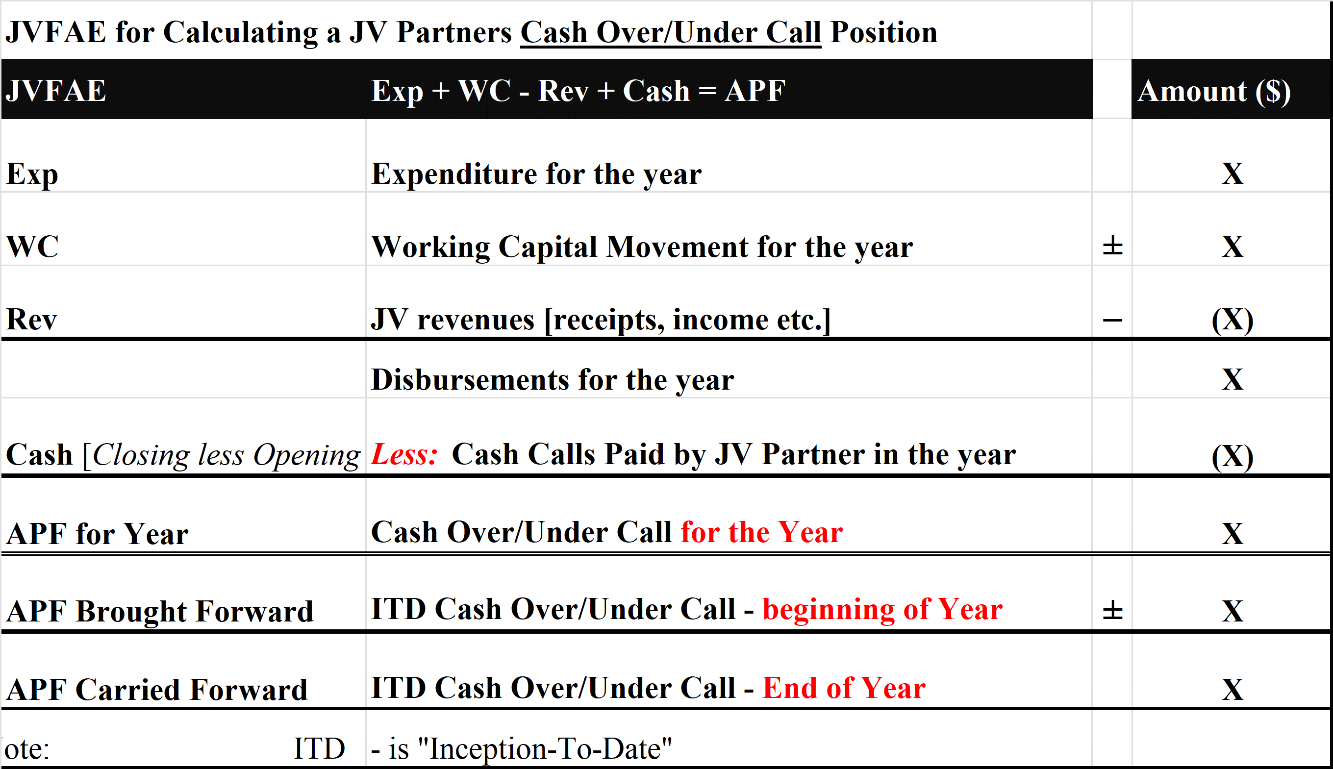
Accounting & Auditing Issues in JVs
    JV Accounting Fundamentals
  The JV Fundamental Accounting Equation (JVFAE)
  Monthly Returns 001/A/B aligns with the JV Fundamental Accounting Equation

Slide 132
–
Accounting & Auditing Issues in JVs
    The Billing Statement
102
Facilitator
Terkimbi
Time
30 minutes

Slide 133
Accounting & Auditing Issues in JVs
THE BILLING STATEMENTS
Billing Statements
Actuals
Focus on ACTUAL EXPENDITURE
Provides Partners with details of ACTUAL EXPENDITURE and MOVEMENTS IN WORKING CAPITAL for the previous month and for the year to-date
Enables Partners to update their own accounting records

Slide 134
Accounting & Auditing Issues in JVs
The Billing Statements
Production of the Billing Statement
PRODUCTION OF BILLING
STATEMENT
Venture Ledger
Trial Balance
ACT
VALUE
XXX XXXXX
Partner A 60%
Partner B 20%
Partner C 20%
BILLING
STATEMENT
GROUP
XXX XXXXX
XXX XXXXX
XXX XXXXX
XXX XXXXX
XXX XXXXX
XXX XXXXX

Slide 135
Accounting & Auditing Issues in JVs
The Billing Statements
Biulling Statement Deliverables
PROVIDES PARTNER WITH:
(i) ACTUAL EXPENDITURE
&
(ii) MOVEMENT IN WORKING CAPITAL
FOR
- CURRENT MONTH
- YEAR TO DATE
(iii) DATA FOR PARTNERS’
ACCOUNTING RECORDS.

Slide 136
Accounting & Auditing Issues in JVs
The Billing Statements
EXPENDITURE PROCESS FLOW
INVOICE
END MONTH
LEDGER RUN
COST
LEDGER
200
ROLL
UP
GL
VAT
WHT
+10
- 10
+210
DR
CR
CR
WIP
+ 210
Vend.
-200
WHT
- 10
DISBURSEMENT
WIP 210
WC (A/C PAYABLE) - 210
GL SUMMARY
FUNDING
BILLING STATEMENT
BANK 210

Slide 137
Accounting & Auditing Issues in JVs
The Billing Statements
BILLING STATEMENT FORMAT
SOURCE
CURRENCY
EXPLORATION EXPENDITURE
PRODUCTION CAPITAL EXPENDITURE
OPERATING EXPENDITURE
MOVEMENTS ON WORKING CAPITAL
LONG TERM RECEIVABLES
OTHER PROFIT & LOSS ITEMS
FUNCTIONAL
CURRENCY
$
N
$
N
DISBURSEMENTS
CURRENT PERIOD CASH CALL
MOVEMENTS ON C/As WIITH OTHER PARTNERS
MOVEMENT ON BANK ACCOUNTS
MOVEMENTS ON CASH CALL RECEIVABLE
OVERDUE SUPPLIERS INVOICES
INTERVENTURE CURRENT ACCOUNTS
FUNDING

Slide 138
Accounting & Auditing Issues in JVs
The Billing Statements
DISBURSEMENTS
EXPLORATION CAPITAL EXPENDITURE
PRODUCTION CAPITAL EXPENDITURE
OPERATING EXPENDITURE
MOVEMENT IN WORKING CAPITAL
OTHER PROFIT & LOSS ITEMS

Slide 139
Accounting & Auditing Issues in JVs
The Billing Statements
WORKING CAPITAL MOVEMENTS IN B/S
COMPONENTS
- MATERIALS
- ACCOUNTS RECEIVABLE
- ACCOUNTS PAYABLE
ACCRUALS
DIRECT MATERIALS
Budget included in Project costs, Cash-called when purchases are made
INDIRECT MATERIALS
Costs budgeted for, included as part of cash-call

Slide 140
Accounting & Auditing Issues in JVs
BILLING STATEMENTS
FUNDING
CURRENT PERIOD CASH CALL
CURRENT ACCOUNT WITH OTHER PARTNERS
BANK ACCOUNTS
CASH CALL RECEIVABLE
OVERDUE SUPPLIER INVOICES
OVERDUE SIPC CURRENT ACCOUNT CHARGES
INTER-VENTURE CURRENT ACCOUNTS
GAS/ULLAGE FEES RECEIVABLE

Slide 141
Accounting & Auditing Issues in JVs
The Billing Statements
BILLING STATEMENTS DETAILED TRANSACTIONS TRAIL
Pick an item on the Billing Statement
Identify the Billing Statement Group Code (BSGC)
Lookup the accounts mapping to the BSGC on the Accounts Mapping Report
If the Account is a Rollup Account then look up the Cost Ledger centres rolling up to it on the Level 2 report
If the Account is a Non Rollup Account, then details of the transactions in the Account centre will be in the General Ledger Transactions Listing
Details of the transactions in the Account centre will be in the Cost Ledger Transactions Listing

Slide 142
–
Accounting & Auditing Issues in JVs
    JV Reporting
102
Facilitator
Terkimbi
Time
15 minutes

Slide 143
Accounting & Auditing Issues in JVs
    JV Reporting
Objectives
The JOA mandates Returns and Reports that the Operator is to provide to non-Operators
The reports are designed to facilitate JV partner recording of JV transactions in their own books, checking their Cash Over/Under Call position, providing their capacity to dispute a Cash call, exercising oversight over the Operator, including the right to additional reports, information and/or explanations on any matter
The returns and reports must reflect actual transactions of the Joint Operations so these returns and reports must be generated from JV records and books of accounts.
These operational reports are designed to provide performance information and give JV partners financial information about their respective positions re Cash Calls, Crude Oil Liftings, etc, and are also aimed at providing assurance that Joint Operations are being conducted in an orderly and workmanlike manner in the best interest of the partners. :
In order to give comfort to JV partners, it is critical that these reports are derived from and are agreement with the underlying JV books, and that they are presented in accordance with the Uniform Accounting Policies Procedures outlined in the JOA.

Slide 144
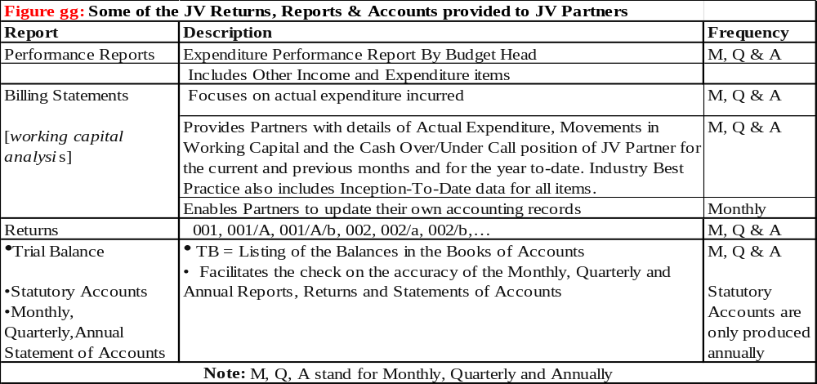
Accounting & Auditing Issues in JVs
    JV Reporting
Objectives
Some of the Returns, Reports & Accounts provided to Non-Operators

Slide 145
–
Accounting & Auditing Issues in JVs
    The Non - Operators’ Audit Rights
102
Facilitator
Terkimbi
Time
15 minutes

Slide 146
Accounting & Auditing Issues in JVs
The Non - Operators’ Audit Rights
Rights vested in Article 6.8 of the JOA for 1991 Joint Ventures. Various PSCs and other contracts have same clauses in respective agreements.
  Article 6.8 of the JOA defines the Audit Rights of the JV partner. That the JV partner “… may carry out or cause to be carried out … periodic audits of the books of accounts and all records relating to the Joint Operations”.
The Audit Rights are absolute and covers everything in the books including prior period transactions and balances, whether nil balances or otherwise. The Non-Operator chooses what they want to audit during the periodic audits of (a) the books of accounts, and (b) all records relating to the Joint Operations.
Non-operated partners utilize Joint Venture Audits as a key tool “ to maximize value of non-operated assets, recover or save costs and detect early warning signs of compliance related issues” (Duff and Phelps).
The Audit Right is for the performance of periodic audits (audits; meaning more than one audit). The JOA does not define or limit the audit program. It is for the Non-Operator to decide.

Slide 147
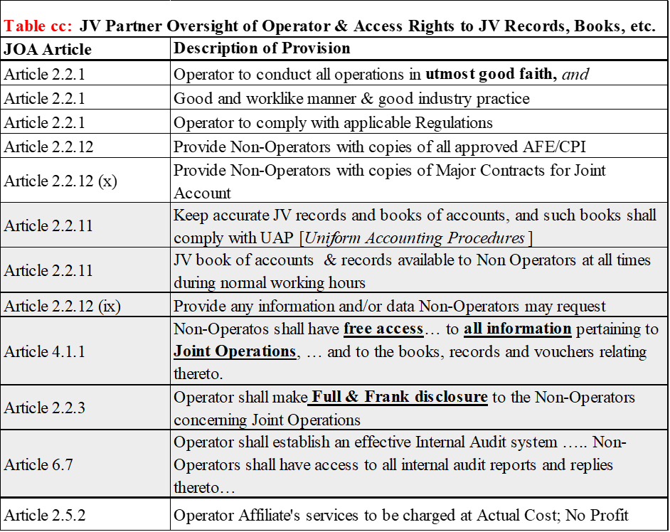
Accounting & Auditing Issues in JVs
The Non - Operators’ Audit Rights
The specific provisions of the 1991 JOA that provide for Non- Operator oversight of the Operator and Joint Operations financial affairs, together with non-Operator full access rights to JV records, books, information, explanations, etc
Non- Operators Oversight of Operator & Access to JV Books & Records

Slide 148
–
Accounting & Auditing Issues in JVs
    The Cost Allocation Process
102
Facilitator
Terkimbi
Time
20 minutes
Overview
Allocation cycles
Allocation bases
Cost allocation methodology
Examples

Slide 149
Accounting & Auditing Issues in JVs
The Cost Allocation Process
Overview
To provide an understanding of the cost allocation process and the methodology/mechanism adopted in SNEPCo.

Slide 150
Accounting & Auditing Issues in JVs
The Cost Allocation Process
Overview
WHAT IS COST ALLOCATION?
Cost allocation is the process of identifying, aggregating, and assigning to cost
objects an equitable proportion of the cost of activities that serve all of them.
It occurs when costs are incurred for multiple cost objectives.
The principles of cost allocation includes:
Simplicity Transparency
Consistency Equity & Fairness
Cost/Benefit Efficiency
Reasonableness Frequency of Allocation

Slide 151
Accounting & Auditing Issues in JVs
The Cost Allocation Process
Overview
Cost Allocation Principles
Simplicity: the cost allocation approach and basis should be simple, easy to understand and implement;
Consistency: a uniform cost structure, allocation basis and approach should be adopted by entities that exist within the same company;
Equity & Fairness: the cost allocation basis should be activity based, reflecting the measure of service derived from the service;
Reasonableness: the defined allocation basis should be compliant with the accounting provisions/requirements of the identified cost;
Transparency: all cost items should have an audit trail;
Cost/Benefit efficiency: the cost allocation process should be as efficient as possible such that the cost f implementing the proposed process is materially insignificant when compared to the costs to be allocated;
Frequency of Allocation: the accumulation and allocation of shared costs should align with the normal month end processing, capturing all costs realised in the reporting period.

Slide 152
Accounting & Auditing Issues in JVs
The Cost Allocation Process
Overview
Cost Allocation Principles
to determine the true financial performance of each operation, project or operating entity;
to process the sharing of the common costs amongst the benefiting asset/projects and also to facilitate the sharing of related and incidental major project overheads costs amongst the projects supported in the year;
helps an organization to achieve cost effectiveness, centralization of services, economies of scale and efficiency.

Slide 153
Accounting & Auditing Issues in JVs
The Cost Allocation Process
Overview
Terms
Common cost: are costs shared/sharable by 2 or more activities and are not directly attributable to a specific project, process or activity.
Cost Objects: A cost object is any activity or item for which you want to separately measure costs, i.e. the beneficiary or the reason for performing an activity e.g. cost centres, projects.
Cost objective: the purpose for which the cost allocation action is being carried out for;
Allocation cycle: defines a group of allocation segments and is created to represent different business functions or teams and their accumulated costs within a period to be allocated. E.g. AU00IA is a cycle maintained for exploration business function;
Allocation Segment: is a mechanism within an allocation cycle that defines specific sender – receiver relationship in terms of cost object groups, cost element groups, sender and receiver rule. E.g. AUOOIA-01: Exploration manpower costs is a segment within the allocation cycle AU00IA;
Allocation bases: These are statistics or basis upon which costs are allocated from the sender to the receiver. E.g. timewriting, latest estimate, budget, desktop count, e.t.c.These bases are agreed and updated annually;

Slide 154
Accounting & Auditing Issues in JVs
The Cost Allocation Process
Overview
Terms
Frequency of allocation: timing of the cost allocation which could be monthly, quarterly or annually;
Cost element: these are general ledgers accounts that exist to serve as identifiers for the type of costs to be allocated by each team e.g. A700010 : Salary cost; A900010 : Service charge e.t.c.
Primary cost element: These are gl accounts that are created in the chart of accounts to record costs that have been incurred within a reporting period and accumulate costs from several cost objects and range from A7XXXXXX – A8XXXXXX; G7XXXXXX – G8XXXXXX.
Secondary cost element: These are gl accounts that exist in the Cost Object module and are used to allocate the costs that have been accumulated in the primary cost elements to the receivers based on the relevant allocation basis.
Venture: an entity that exists to carry out business functions, achieve set objectives and incurs costs to achieve these objectives with the aim to maximising stakeholders wealth. E.g. 425001 which a venture that is used to pool all the common costs to be allocated by the service providers to the service receivers.

Slide 155
Accounting & Auditing Issues in JVs
The Cost Allocation Process
Cost Allocation Cycles
Allocation cycles as mentioned above represents teams or business functions.
Illustration
The table below depicts an example of allocation cycles and the teams they represents:
Cycle Name | Start date | Cycle description | Allocation basis | Frequency
AU00FB | 01.01.2011 | Medical Ops & admin | STAFF NUMBER | QUARTERLY
AU00FC | 01.01.2011 | INFRASTRUCTURE | Office space allocation | MONTHLY
AU00IT | 01.01.2011 | IT - INFORMATION TECHNOLOGY | DESKTOP | MONTHLY
AU00JD | 01.01.2011 | Land Logistics | REQUEST | MONTHLY
AU00SS | 01.01.2011 | Subsea Costed Work Center | TIMEWRITING | MONTHLY
AU00SC | 01.01.2011 | SUPPLY CHAIN | BUDGET/LE | QUARTERLY
AU00CD | 01.01.2011 | External Affairs | Fixed % OF PROJECTS | QUARTERLY
AU00JA | 01.01.2011 | G & A Allocation | Fixed % OF PROJECTS | YEARLY
We can see from the table above the cycles, their descriptions and the frequency with which the allocation bases are used to share common costs that have been incurred within a period.
For instance Au00FC : Infrastructure is a cycle that represents the Infrastructure team who ascertain the office floor space occupied by each business function, and derive a percentage allocation of the office floor space to the total floor space sqms occupied by all business function.

Slide 156
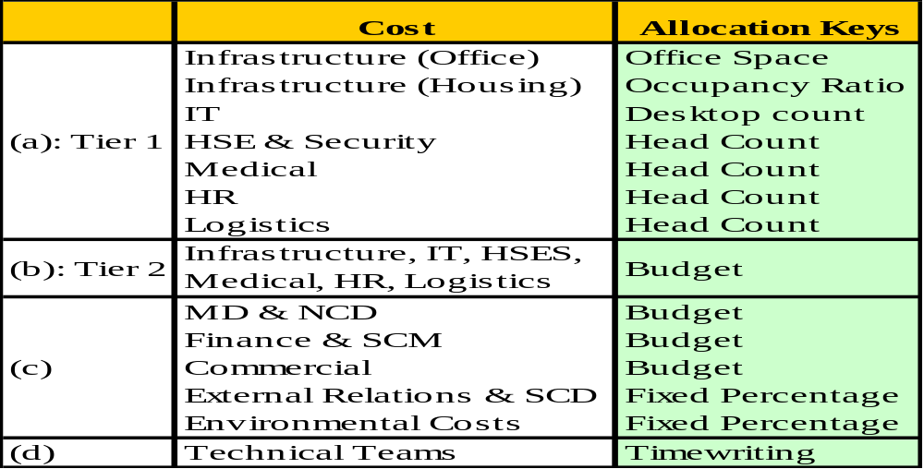
Accounting & Auditing Issues in JVs
The Cost Allocation Process
Cost Allocation Bases
In line with NNPC/NAPIMS UAPC

Slide 157
Accounting & Auditing Issues in JVs
The Cost Allocation Process
Cost Allocation Methodology
METHODOLOGY Common costs which have been accumulated by primary cost elements are pooled in venture 425000 are allocated with secondary cost elements to receiving cost objects using the two tier method. The two tier method is required where the allocation keys/basis does not result in a direct allocation to the ultimate beneficiary (fields, assets or projects). Cost incurred by the sender cost centers/support departments (IT,HR & Facilities) are charged directly to the technical departments, ventures, field or projects if the costs can be traced directly to the receivers; or accumulated in the support department’s cost pool ( sender cost pool) for subsequent allocation to the intermediate cost pool, technical departments, ventures, field or projects using a pre defined allocation basis for each cost item.

Slide 158
Accounting & Auditing Issues in JVs
The Cost Allocation Process
Cost Allocation Methodology
TWO TIER METHODOLOGY EXPLAINED Tier 1: This tier mainly focuses on the allocation of costs from the sender cost centers to the penultimate or ultimate beneficiaries. The cost pooled in the cost objects of teams that are activity based (logistics, HSE, Infrastructure) are allocated to the technical teams/penultimate beneficiaries (Well engineering, exploration, development ) and Nontechnical teams/ support functions (finance, hr, IT) common cost pool. At the end of the Tier 1 allocation, costs in the sender cost pools must be fully charged out either directly to the technical departments, fields or projects; or retained in the intermediate cost pool for subsequent allocation to Tier 2. Tier 2: This tier focuses on allocating costs in the technical departments and the intermediate cost pool costs to the ultimate beneficiary. Upon receipt of its share of the costs from the sender cost centre, the technical department will allocate these costs to the various assets, ventures, fields or projects based on the size of the ventures, fields or projects. The costs accumulated in the intermediate cost pool will also be allocated to the various ventures, fields or projects based on the size of the ventures, fields or projects. The size of each venture will be determined by the budget for the venture project.

Slide 159
Accounting & Auditing Issues in JVs
The Cost Allocation Process
Cost Allocation Methodology
ILLUSTRATION OF TIER 1 COST.
Tier 1 costs are allocated using Staff numbers and/or office space allocation, while the tier 2 cost from the technical departments, other support departments are allocated to the fields and projects using budget or latest estimate.
Below is a diagrammatic representation of the two tier methodology:
Cycle Name | Start date | Cycle description | Allocatiion basis | Frequency | TIER
AU00FC | 01.01.2011 | INFRASTRUCTURE | Staff numbers & office space | QUARTERLY & Monthly | 1
AU00IF | 01.01.2011 | INFRASTRUCTURE - TIER 2 | BUDGET/LE | QUARTERLY | 2

Slide 160
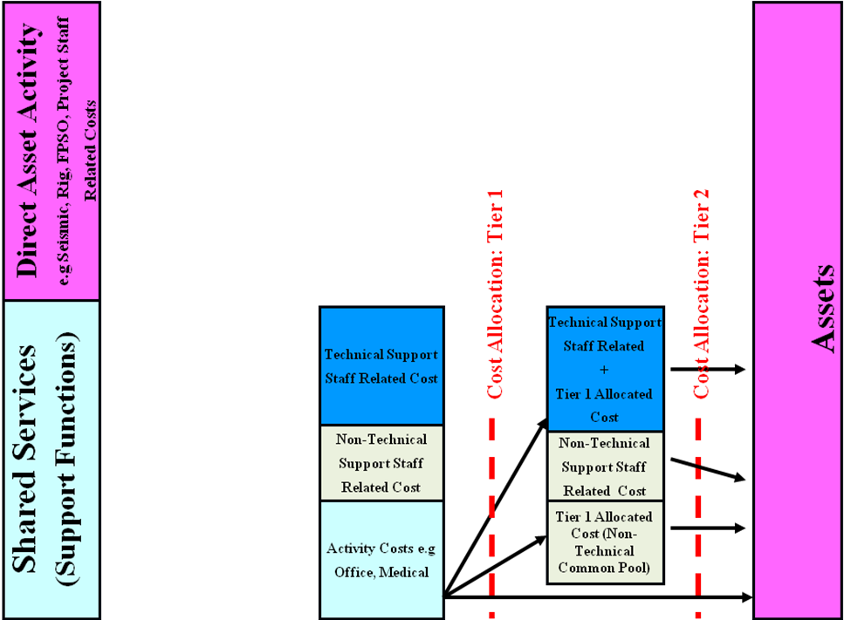
Accounting & Auditing Issues in JVs
The Cost Allocation Process
Cost Allocation Methodology
160

Slide 161
Accounting & Auditing Issues in JVs
The Cost Allocation Process
Cost Allocation Methodology
COST RECOVERY BY SERVICE PROVIDER Cost recovery represents a crucial step in the cost allocation as all costs allocated by a service provider to service recipients must be recovered within an agreed timeline. The monthly recovery cycle should be fairly constant across entities within the same company. Billed costs should be fully recovered based on pre determined recovery cycle agreed to by all parties upon the receipt of the bill by the service recipient. The amounts to be recovered are pooled in cost elements on a monthly basis after the determination of zero over/under absorption between the service provider cost centre and the recipient cost centres. These costs are moved via the cost recovery process to other debtors gl accounts to be invoiced/billed to the service recipients.
161

Slide 162
15 Minutes
Accounting & Auditing Issues in JVs
We’ll resume our meeting in:

Slide 163
Syndicate Session - Understanding Billing Statements
Section 1
Syndicate Session - Understanding Billing Statements

Slide 164


Syndicate Session - Understanding Billing Statements
The Billing Statements SYNDICATE
UNDERSTANDING BILLING STATEMENTS

Slide 165
60 Minutes
Accounting & Auditing Issues in JVs
We’ll resume our meeting in:

Slide 166
Understanding Financial Statement of Upstream Entities
Section 2
Understanding Financial Statement of Upstream Entities

Slide 167
Understanding Financial Statement of Upstream Entities
–
Why Balance Sheet of Upstream Oil & Gas Company Matter?
102
Facilitator
Terkimbi
Time
40 minutes

Slide 168

Why Balance Sheet of Upstream Oil & Gas Company Matter?
Understanding Financial Statement of Upstream Entities
There are a number of unique items that show up on oil and gas company balance sheets.
The items include proved reserves, probable reserves, possible reserves, asset retirement obligation, and the derivative fair value items.
They are important when assessing and comparing oil and gas companies and can be used to better understand the individual company.
Proved, Probable, and Possible Reserves
Proved reserves, probable reserves, and possible reserves refer to the potential crude oil that can be extracted by an oil and gas company.
Notes:
The quantity of the oil that can be extracted from an oil reserve always involves some uncertainty in the estimate. It is based on the amount of geological and engineering information available regarding the oil reserve in question.
The levels of uncertainty when estimating the amount of oil in the reserves vary, and that is why reserves are separated into two broad categories: proved and unproved. Within the category of unproved, oil reserves fall under the sub-categories of probable and possible.
Proved reserves are oil reserves with the highest certainty. The oil that can be extracted from such reserves must show at least a 90% probability of recovery to be classified as such. It is based on geological and engineering data and must also take into account operating methods, economic conditions, and government regulations.
The unproved reserves category encapsulates the probable and possible categories. Unproved reserves come with greater uncertainty when it comes to either technical, economic, or regulatory factors. It leads to a less than 90% probability of recovery.
An oil reserve with a recovery probability of less than 90% but at least 50% falls under the probable category. Here, there is a reasonable likelihood of recovery; however, circumstances such as the lack of sufficient geological data or the inability to institute proper underground controls prevent a higher level of certainty.
The last commonly used category falls under possible. The probability of possible oil reserves is highly uncertain and falls between the 10% and 50% threshold for recovery. Often, reserves that are known are categorized here when the ability to produce at commercial rates comes into question.
Oil reserves with extreme uncertainty can fall within the category of contingent reserves. The probability of certainty regarding such reserves is less than 10%. The contingent reserves line item is seldom seen on oil and gas balance sheets.

Slide 169
Why Balance Sheet of Upstream Oil & Gas Company Matter?
Understanding Financial Statement of Upstream Entities
Proved reserves: Greater than 90% probability of recovery
Probable Reserves: Between 50% and 90% probability of recovery
Possible Reserves: Between 10% and 50% probability of recovery
Contingent Reserves: Less than 10% probability of recovery
The three-line items above are classified as a long-term asset and show up on the balance sheet under property, plant, and equipment.
Asset Retirement Obligation (ARO)
legal obligation to clean up, shut down, or retire a long-lived asset
activities include:
  The removal of any production equipment
  The removal of facilities at each oil well site
  The restoral of surface land to its original state prior to extraction
recorded in the period in which it is incurred if a reasonable approximation of the fair value can be made. - acquisition or during construction.
If a reasonable approximation cannot be made,, then ARO recorded when it can be approximated.
Shows up in the balance sheet under long-term liabilities.
Notes:
The quantity of the oil that can be extracted from an oil reserve always involves some uncertainty in the estimate. It is based on the amount of geological and engineering information available regarding the oil reserve in question.
The levels of uncertainty when estimating the amount of oil in the reserves vary, and that is why reserves are separated into two broad categories: proved and unproved. Within the category of unproved, oil reserves fall under the sub-categories of probable and possible.
Proved reserves are oil reserves with the highest certainty. The oil that can be extracted from such reserves must show at least a 90% probability of recovery to be classified as such. It is based on geological and engineering data and must also take into account operating methods, economic conditions, and government regulations.
The unproved reserves category encapsulates the probable and possible categories. Unproved reserves come with greater uncertainty when it comes to either technical, economic, or regulatory factors. It leads to a less than 90% probability of recovery.
An oil reserve with a recovery probability of less than 90% but at least 50% falls under the probable category. Here, there is a reasonable likelihood of recovery; however, circumstances such as the lack of sufficient geological data or the inability to institute proper underground controls prevent a higher level of certainty.
The last commonly used category falls under possible. The probability of possible oil reserves is highly uncertain and falls between the 10% and 50% threshold for recovery. Often, reserves that are known are categorized here when the ability to produce at commercial rates comes into question.
Oil reserves with extreme uncertainty can fall within the category of contingent reserves. The probability of certainty regarding such reserves is less than 10%. The contingent reserves line item is seldom seen on oil and gas balance sheets.

Slide 170
Why Balance Sheet of Upstream Oil & Gas Company Matter?
Understanding Financial Statement of Upstream Entities
Derivative Fair Value
a very commonly seen item on oil and gas company balance sheets.
include forwards, futures, and options.
Derivative fair value line can be either an asset or a liability.
  If a company has hedged its position and has entered into a derivative contract to sell at a set price, the derivative fair value item will show up as an asset.
  If a company has hedged its position and entered into a contract to buy at a set price, the derivative fair value item will show up as a liability.
Notes:
Derivative Fair Value
The derivative fair value item is not specifically unique to only oil and gas companies. It is, however, a very commonly seen item on oil and gas company balance sheets. Within the industry, the prices of commodities, such as oil, are set by the market. To deal with constantly fluctuating prices, oil and gas companies can hedge their position using derivatives. The derivatives include forwards, futures, and options.
For example, a company may engage in a forward contract to sell a set amount of oil at $50 a barrel. The line item, as its name suggests is recognized at its fair value. The derivative fair value line can be either an asset or a liability. If a company has hedged its position and has entered into a derivative contract to sell at a set price, the derivative fair value item will show up as an asset. If a company has hedged its position and entered into a contract to buy at a set price, the derivative fair value item will show up as a liability.

Slide 171
Understanding Financial Statement of Upstream Entities
Why are Oil and Gas Company Balance Sheet Items Important?
  Since such companies are very dependent on the finite resource they are extracting, assessing the availability and probability it can be extracted at can help give a proxy to the company valuation. For example, when screening companies, one may look at how many proved reserves they own. Reserves can also be made into valuation multiples to compare different companies.
  Understanding the asset retirement obligation is also very important in assessing an oil and gas company. The asset retirement obligation line item can be monitored over time to determine the costs of retiring the facilities that are constructed over the period of extraction. If a known number of facilities or equipment will be used for future extraction, understanding the line item can help forecast the future costs of the company.
  Finally, identifying and assessing the derivative fair value items that may be present on the company balance sheets can give an idea as to how hedged the company’s position may be. It can be a component that factors into the risk profile of a company. It can also be an indicator of how prices are capped at a company, i.e., in situations where oil prices increase dramatically.
Notes:
Derivative Fair Value
The derivative fair value item is not specifically unique to only oil and gas companies. It is, however, a very commonly seen item on oil and gas company balance sheets. Within the industry, the prices of commodities, such as oil, are set by the market. To deal with constantly fluctuating prices, oil and gas companies can hedge their position using derivatives. The derivatives include forwards, futures, and options.
For example, a company may engage in a forward contract to sell a set amount of oil at $50 a barrel. The line item, as its name suggests is recognized at its fair value. The derivative fair value line can be either an asset or a liability. If a company has hedged its position and has entered into a derivative contract to sell at a set price, the derivative fair value item will show up as an asset. If a company has hedged its position and entered into a contract to buy at a set price, the derivative fair value item will show up as a liability.

Slide 172

Understanding Financial Statement of Upstream Entities
Why are Oil and Gas Company Balance Sheet Items Important?
Notes:
Derivative Fair Value
The derivative fair value item is not specifically unique to only oil and gas companies. It is, however, a very commonly seen item on oil and gas company balance sheets. Within the industry, the prices of commodities, such as oil, are set by the market. To deal with constantly fluctuating prices, oil and gas companies can hedge their position using derivatives. The derivatives include forwards, futures, and options.
For example, a company may engage in a forward contract to sell a set amount of oil at $50 a barrel. The line item, as its name suggests is recognized at its fair value. The derivative fair value line can be either an asset or a liability. If a company has hedged its position and has entered into a derivative contract to sell at a set price, the derivative fair value item will show up as an asset. If a company has hedged its position and entered into a contract to buy at a set price, the derivative fair value item will show up as a liability.

Slide 173
Understanding Financial Statement of Upstream Entities
–
Measuring Performance
102
Facilitator
Terkimbi
Time
10 minutes

Slide 174
Key result Areas for an Oil and gas company
Understanding Financial Statement of Upstream Entities
Return on Capital Employed ( ROCE)
  Upstream oil and gas is a capital-intensive business, from acquisition, exploration, development and production so this measure is an important indicator of returns
2. Cash Margin/Operating Cash per barrel/boe
  Measures company operational efficiencies ( cash flow from operating activities) to produce a boe and generate $1 of revenue on entitlement basis, excluding working capital and non operational expenses and special items.)
Free Cashflow Generation
  Measures how effective the company is controlling its expenditure- both operating and capital expenditure and provides which cost needs to be controlled such as variable cost- (volume vs. price) The indicator that basically challenge company to achieve more with less- via cost savings.
4. Per boe Finding Cost and Development Cost
  Measures unit exploration cost and development cost for every proved reserves added during the period.

Slide 175
Understanding Financial Statement of Upstream Entities
Key result Areas for an Oil and gas company
5. Reserves Replacement rates
  Measures the company’s ability to replace its reserves consumed in production and is a measure of long term sustainability of the company
Total Shareholders Return
  Indicator measures how share price reacts as a result of both external and internal factors such as macro and micro-economics that effect demand and supply, geopolitical situations that may effect the oil price.
  In addition, internal factors within the organisation i.e.operational and financial such as project delivery including exploration success, production target, reserve addition, plant availability, HSE performance and financial indicators also have effect on the share price movement during the year.
  Key Performance Indicators to be monitored and eventually reported to the stakeholders. It is very important also what to develop indicators that are meaningful, provide insights to the investors and that benchmark among the peers can be conducted to know where the company stands among the peers, and be the darling of the investors.

Slide 176
Understanding Financial Statement of Upstream Entities
–
102
Understanding Scorecard Architecture
Facilitator
Terkimbi
Time
10 minutes

Slide 177
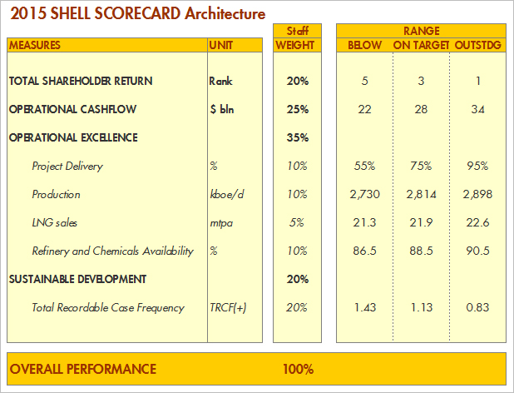
Understanding Financial Statement of Upstream Entities

Slide 178
Financial Reports - Relevance and Reliability in Audit
Section 3
Financial Reports - Relevance and Reliability in Audit
    Relevance and reliability of financial reports
    Significance of Internal Control in financial reporting
    Compiling Audit Reports
    Relevance of financial reporting in Audit
    Management’s responsibility for financial statements
    Fraud and Auditor’s Responsibilities

Slide 179
Financial Reports - Relevance and Reliability in Audit
–
Relevance and Reliability of financial reports
102
Facilitator
Terkimbi
Time
5 minutes

Slide 180
Relevance and reliability of financial reports
Financial Reports - Relevance and Reliability in Audit
Relevance and reliability are the two main accounting principles.
Relevance
  information available for a given set of financial figures in order to accommodate the user of the financial statements in making an informed decision.
Reliability
  level of trust a decision maker can give to the financial figures presented in the financial statements.
  Misstatement and omission from the financial statements of important information which may affect the decision of the users may render the reliability in to danger.

Slide 181
Relevance and reliability of financial reports
Financial Reports - Relevance and Reliability in Audit
Example # 1
Alpha industry has a customer with whom the company has credit line of $5 millions. The total assets of the company are $15 million. Later, it comes to the knowledge of the company that the same customer has gone into liquidation. This information is relevant and must be incorporated into the financial statements even if it comes into knowledge after the balance sheet date but before the date of issue.
However, if the amount of default is $1000, then there is no need to disclose this information as the materiality of the transaction amount renders the information irrelevant.

Slide 182
Relevance and reliability of financial reports
Financial Reports - Relevance and Reliability in Audit
Example # 2
YTC is a mid-sized company engaged in producing chemical for industrial clients. Due to producing low quality chemicals and causing severe damage to one of its client, a lawsuit has been filled. Board of directors and lawyers of YTC are sure that if the case comes against them, it would lead to the liquidation of the company on the order of the court. YTC has to disclose this information in its financial statements to ensure that its reports are relevant and reliable. This information helps the stakeholders in making decisions and make future strategies. Non disclosure could lead to decisions which may prove detrimental to their interest.

Slide 183
Relevance and reliability of financial reports
Financial Reports - Relevance and Reliability in Audit
Example # 3
The TUK Plc is engaged in providing cable TV services at metropolitan level. Due to its excellent performance and customer service, it has achieved increased sales and as a result, it is enjoying higher profits and improved cash flows. Their earnings per share (EPS) figure have risen from $10 to $12 this year. TUK Plc is required to disclose this information in its financial statements. This helps the users of the financial in making informed decisions.

Slide 184
Financial Reports - Relevance and Reliability in Audit
–
Significance of Internal Control in financial reporting
102
Facilitator
Terkimbi
Time
5 minutes

Slide 185
Significance of Internal Control in Financial Reporting
Financial Reports - Relevance and Reliability in Audit
Internal control over financial reporting (ICFR or ICOFR) is a process consisting of policies and control procedures to assess financial statement risk and provide reasonable assurance that a company prepares reliable financial statements. Detailed, fair, and accurate financial records with receipts for transactions are maintained by employees and approved by management for corporate governance
KPMG’s Risk Compliance Practice identifies 7 pillars of IOCFR (internal controls over financial reporting) to assess IOCFR program progress:
1. Strategy
2. Risk assessment
3. Entity-level controls (ELCs)
4. Control selection
5. Testing strategy
6. Evaluating results
7. Governance”

Slide 186
Significance of Internal Control in Financial Reporting
Financial Reports - Relevance and Reliability in Audit
What is the COSO Framework for Internal Control?
The Committee of Sponsoring Organizations of the Treadway Commission (COSO) issued a framework for internal control in 1992, with an update in 2013. COSO also provides other guides relating to “internal control, risk management, governance, and fraud deterrence”.
The COSO framework is useful for effective ICFR (internal control over financial reporting), including cash controls, accounts payable internal controls, and AP financial controls.
The COSO Internal Control-Integrated Framework includes:
1. Control environment
2. Risk assessment
3. Control activities
4. Information & communication
5. Monitoring activities

Slide 187
Significance of Internal Control in Financial Reporting
Financial Reports - Relevance and Reliability in Audit
What is the Role of Companies in ICFR?
Companies establish internal control systems with policies and procedures that include segregation of duties, invoice document matching, and authorizations and approvals. For proper separation of duties, the same employee isn’t handling assets like cash and recording accounting transactions for revenue, costs, assets, expenses, and other expenditures.
Businesses establish a control environment that includes the corporate culture, an ethical executive management tone that encourages proper financial reporting, and the Audit Committee’s review of the financial statements as a source of high-level oversight.

Slide 188
Significance of Internal Control in Financial Reporting
Financial Reports - Relevance and Reliability in Audit
ICFR relates to the preparation of financial statements and includes data security requirements.
The financial statements should be internally reviewed, including authorizing journal entries, reconciling accounts to the general ledger, comparing financial statements to the underlying accounting records, and evaluating reasonableness through an analytic review.
FP&A procedures like trend analysis, ratios computation, and variance analysis comparing actual with budgeted amounts should be scrutinized as another check on financial statement accuracy.
In the US, On an annual basis, management’s assessment of internal control over financial statements is performed. Management of public companies reports the results regarding reasonable assurance of the operating effectiveness of ICFR at the business in the 10-K.

Slide 189
Significance of Internal Control in Financial Reporting
Financial Reports - Relevance and Reliability in Audit
Role of Auditors in ICFR
Auditors assess their client’s system of internal control procedures for ICFR, including assessing risk of material misstatement of the financial statements and sample testing of transactions. Auditors determine if deficiencies to the extent of material weaknesses in internal control exist. The extent of audit testing increases with weak internal controls at a client company, increasing the annual audit bill.
In connection with an annual audit or review of the financial statements, auditors issue reports to their privately-held and publicly-traded clients on internal control matters requiring improvement. These reports are presented to management and the Audit Committee of the Board of Directors. Companies should correct these internal control deficiencies on a timely basis.
As small companies grow to achieve different stages of growth and add employees, their internal controls, including ICFR, should improve because separation of duties, review, approval, and IT systems improve.

Slide 190
Financial Reports - Relevance and Reliability in Audit
–
Compiling Audit Reports
102
Facilitator
Terkimbi
Time
5 minutes

Slide 191
Financial Reports - Relevance and Reliability in Audit
Considerations when compiling an audit report
When writing a report there are five key areas which you should always consider:
  1. What is the purpose of the report?
  2. Who will read it?
  3. How to start.
  4. The report structure.
  5. Style and presentation.
.

Slide 192
Financial Reports - Relevance and Reliability in Audit
A Good Audit Report -
is one that clearly communicates the objectives, scope, and findings of an audit engagement, and in doing so, motivates its readers to take internal audit’s recommended actions.(How to Write a Good Audit Report: 4 Key Resources to Follow | AuditBoard)
conveys a clear message to the reader – Idea is to communicate, not to report (The IIA Standard 2410 )
should be free of judgment, written in a tone that appeals to the reader instead of making accusations.
should be brief and to the point.
“The length of the audit report, if one is even needed, should be just enough to tell the consumers of the report what they need to know – and no more.” - Norman Marks
should also steer clear of any jargon since the report may go to external parties.
focus should remain to communicate, Communicate, Communicate.

Slide 193
Financial Reports - Relevance and Reliability in Audit
Contents of an Audit Report
Content matters when compiling a good audit report (The IIA Standard 2410 - Criteria for Communications).
Internal auditing standards require audit reports to have a basic structure that most internal auditors follow. The audit report generally includes the following elements:
  Scope and objectives (must).
  Results (must).
  Recommendations and action plans (must).
  Conclusions (must).
  Opinion (should).
  Acknowledgment of satisfactory performance (encouraged).

Slide 194
Financial Reports - Relevance and Reliability in Audit
Useful considerations at the review stage of report writing
  Does the report meet its purpose (terms of reference)?
  Is the report suitable for its intended readers?
  Is the title consistent with the scope of the report?
  Does the summary cover the main points?
  Are the sections and sub-sections of the report logically related, correctly headed and referred to accurately in the contents page?
  Are the component parts given appropriate weight?
  Is the paragraphing adequate
  Has every sentence been checked for: - spelling; - grammar
  - verbosity; - clarity?
  Are any tables and examples clearly set out and properly labelled?
  Is a glossary of special terms necessary?
  Have the right conclusions been drawn?
  Do the recommendations follow naturally from the conclusions

Slide 195
Financial Reports - Relevance and Reliability in Audit
–
Financial Reporting - Relevance in Audit
102
Facilitator
Terkimbi
Time
15 minutes

Slide 196
Financial Reports - Relevance and Reliability in Audit
Impacts of financial reporting issues for the Auditor
The auditor should consider financial reporting issues throughout an audit. Therefore, question scenarios involving these matters could be based in the planning phase, the evidence gathering period, or during the completion stage when the audit opinion is being evaluated. Each of these stages of the audit is discussed in turn below.
Planning phase
Auditor will use risk assessment techniques to assess the client’s business and financial statements for potential problem areas. One type of risk that the auditor will assess is financial statement risk.
Financial statement risk is the risk that components of the financial statements could be misstated, through inaccurate or incomplete recording of transactions or disclosure.
Notes:
The planning phase
At this initial stage of the audit, the auditor will use risk assessment techniques to assess the client’s business and financial statements for potential problem areas. One type of risk that the auditor will assess is financial statement risk. Financial statement risk is the risk that components of the financial statements could be misstated, through inaccurate or incomplete recording of transactions or disclosure. Financial statement risks, therefore, represent potential errors or deliberate misstatements in the published accounts of a business. Financial statement risks could lead to a balance being over or understated in value, or could result in an item being recognised when it should not be, or vice versa, the non-recognition of an item which should be recognised. In addition, financial statement risk could lead to an item being recognised at an inappropriate time, or in incorrect presentation or disclosure of a matter. Clearly, the auditor must understand financial reporting standard requirements in order to assess the risk of an item being recognised, measured, or disclosed incorrectly.

Slide 197
Financial Reports - Relevance and Reliability in Audit
Impacts of financial reporting issues for the Auditor
Gathering evidence
Auditors need to gather sufficient, appropriate evidence regarding financial reporting issues. Of course, one of the matters for which the auditor needs to gather evidence is in relation to compliance with financial reporting standards. A common question requirement here will ask the candidate to ‘comment on the matters to be considered’ in relation to a financial reporting issue. Usually, a second, related requirement will ask the candidate to suggest relevant audit procedures. For an example of this type of question requirement
Some financial reporting matters are considered to be relatively hard to audit, and, in some cases, a particular International Standard on Auditing (ISA) has been issued to provide guidance to the auditor on such matters. An example is ISA 550, Related Parties, which provides guidance for the auditor on the subject of auditing related party transactions. These are the kind of matters which are likely to feature regularly in the exam, so candidates should pay particular attention to financial reporting matters which are the subject of specific ISAs (see ISAs 540–570)
Notes:
Typical matters which should be considered by the auditor in the context of a financial reporting issue may include, for example:
whether the financial reporting issue is relatively complex, or whether the financial reporting issue is subjective, necessitating the use of significant judgement. The existence of either increases the inherent risk that a balance or transaction will be materially misstated the specific requirements of any relevant financial reporting standard, in terms of the recognition, measurement, or presentation or disclosure of the item, and whether, in the context of the scenario, it appears that the requirements have been followed or not the materiality of the item in question, bearing in mind that materiality should be assessed from a quantitative and a qualitative viewpoint the wider impact of an issue on the financial statements, for example, consider the implication of a matter to all of the primary financial statements, and disclosure needed in the notes to the financial statements.

Slide 198
Financial Reports - Relevance and Reliability in Audit
Impacts of financial reporting issues for the Auditor
Reaching an audit opinion
The ultimate impact of financial reporting issues is in arriving at the audit opinion. The auditor must decide whether the financial statements prepared by management comply with relevant standards, and if they do not, the auditor needs to consider the impact on the audit opinion. A non-compliance with standards leading to a material misstatement in the financial statements will result in an opinion modified due to disagreement, which could be an ‘except for’ qualification, or an adverse opinion. For an example of a question in this area, see Paper P7 December 2007 Q5 (a).
On discovering a material breach of financial reporting standards, the auditor should bring the matter to the attention of those charged with governance. This is to highlight the seriousness of the issue, and to ensure that those charged with governance have full awareness of the technical issues involved, and can therefore make an informed decision with regard to amending the financial statements.
Notes:
Ultimately, an auditor of historical financial information cannot hope to perform a quality audit in the absence of a detailed knowledge and understanding of financial reporting standards, which is why such matters will regularly feature in the exam. Well-prepared candidates can score very highly in such questions by demonstrating their knowledge of a financial reporting matter, but more importantly, applying that knowledge to the issue faced by the auditor in the question scenario provided...

Slide 199
Financial Reports - Relevance and Reliability in Audit
–
Financial Statements – Management Responsibilities
102
Facilitator
Terkimbi
Time
5 minutes

Slide 200
Financial Reports - Relevance and Reliability in Audit
Overview of Management Responsibilities relating to Financial Statements
Management Responsibilities relating to Financial Statements Objective and general principal governing Audit (ISA 200) include:
The overall responsibility for the preparation and presentation of the financial statements.
Identifying the financial reporting framework to be used in the preparation and presentation of the financial statements.
Designing, implementing and maintaining internal controls relevant to the preparation and presentation of financial statements that are free from material misstatement whether due to fraud or error.
Selecting and applying appropriate accounting policies.
Making accounting estimates that are reasonable in the circumstances.

Slide 201
Financial Reports - Relevance and Reliability in Audit
Overview of Management Responsibilities relating to Financial Statements
Preparation and Presentation of Financial Statements
An acceptable financial reporting framework should be used by the management in the preparation and presentation of the financial statements. Management should also identify financial reporting framework which is used in preparation and presentation of financial statements. Financial statement should be prepared for general purpose and it should also fulfill the requirement of local laws and regulations.
Designing, implementing and maintaining Internal Controls
Management should agree and acknowledge for such internal control as management determines is necessary to enable the preparation of financial statements that are free from material misstatement, whether due to fraud or error. Internal Control system is very important for determining the time and extent of audit procedures.

Slide 202
Financial Reports - Relevance and Reliability in Audit
Overview of Management Responsibilities relating to Financial Statements
Selection and application of appropriate accounting policies
Management should select and apply accounting policies properly in accordance with relevant standards , rules and regulations so that financial statements providing a true and accurate picture of the state of affairs of the entity. selection and application of appropriate accounting policies depends upon the competence of relevant personnel.
Making reasonable accounting estimates
Management should make reasonable accounting estimates keeping in view the substance of transactions and their impact on financial statements. Accounting estimates should be made in accordance with normal accounting practices prevailing in the market.

Slide 203
Financial Reports - Relevance and Reliability in Audit
–
102
    Fraud and Internal Auditor’s Responsibilities
Facilitator
Terkimbi
Time
10 minutes

Slide 204
What is fraud and corruption?
Financial Reports - Relevance and Reliability in Audit
Fraud
“Dishonestly obtaining a benefit by deception or other means.” [Source: Commonwealth Fraud Control Guidelines 2002, p. 4.]
Dishonest activity causing actual or potential financial loss to any person or organisation including theft of moneys or other property by employees or persons external to the organisation whether or not deception is used at the time, immediately before or immediately following the activity.
Corruption
Dishonest activity in which a director, executive, manager, employee or contractor of an organisation acts contrary to the interests of the organisation and abuses his/her position of trust in order to achieve some personal gain or advantage for him/herself or another person or the organisation.

Slide 205
Examples of Fraud and Corruption
Financial Reports - Relevance and Reliability in Audit
EXAMPLES OF FRAUD | EXAMPLES OF CORRUPTION
Theft/obtaining property/financial advantage by deception | Collusive tendering
Providing false or misleading information/misstatement | Conflicts of interests
Causing a loss (or avoiding or creating a liability) by deception | Receiving inappropriate gifts or entertainment
Using forged or falsified documents | Corrupt payments (‘kick backs’)
False accounting | Internet or e-mail misuse
Money laundering | Leaking confidential or private information / IP
Unlawful use of the organisation’s assets | Serious nepotism and/or collusion
Manipulating expenses, salaries, ghost employees etc. | Bribery or abuse of position of trust

Slide 206
Bribery
Financial Reports - Relevance and Reliability in Audit
A bribe is defined as “any offer, promise or gift of any undue pecuniary or other advantage, directly or through intermediaries, to foreign public officials, in order that the official act or refrain from acting in relation to the official’s duties, in order to obtain or retain business or other improper advantage in international business.”
Paying bribes to Government officials is an offence in almost all jurisdictions with serious consequences (e.g. China)
It is also an offence in OECD countries to pay a bribe to a foreign government official:
  OECD convention (1997) & Foreign Corrupt Practices Act (FCPA) (1977)
Facilitation payments (differing treatment in the legislation)

Slide 207
What are Internal Auditor Responsibilities?
Financial Reports - Relevance and Reliability in Audit
IIA Standard: I210.A2 (updated in 2009)
“Internal auditors must have sufficient knowledge to evaluate the risk of fraud and the manner in which it is managed by the organisation, but are not expected to have the expertise of a person whose primary responsibility is detecting and investigating fraud.”
BUT:
Should conduct audit procedures to identify controls mitigating risk of fraud.

Slide 208
What are Internal Auditor Responsibilities?
Financial Reports - Relevance and Reliability in Audit
Principal mechanism for deterring fraud is control.
Management has primary responsibility for establishing and maintaining controls
Internal auditors are responsible for assisting in the deterrence of fraud by assessing the effectiveness of the system of control
    The organizational environment fosters control consciousness
    Realistic organizational goals and objectives are set
    Written policies exist and actions taken when violations are discovered
    Appropriate authorization policies are in place
    Communication channels provide management with adequate and reliable information
    Recommendations should be made to establish or enhance cost-effective controls to help deter fraud

Slide 209
Fraud & Audit: Identifying Fraud & Corruption Risks
Financial Reports - Relevance and Reliability in Audit
Plan 1 (derived from AAP) – identify high level risk of fraud
  High probability of fraud based on CPI
  History of fraud
  Process being audited
Plan 2
  Discuss high level fraud risk assessment
  Specific risks of fraud and misconduct
  Develop procedures (tests) that would address fraud and misconduct risks
Execution
  Identify indicators (“red flags”) of fraud or misconduct that become apparent during the course of normal audit procedures
  Take appropriate action – involve BID?
Reporting
  Report based on fact, not suspicions

Slide 210
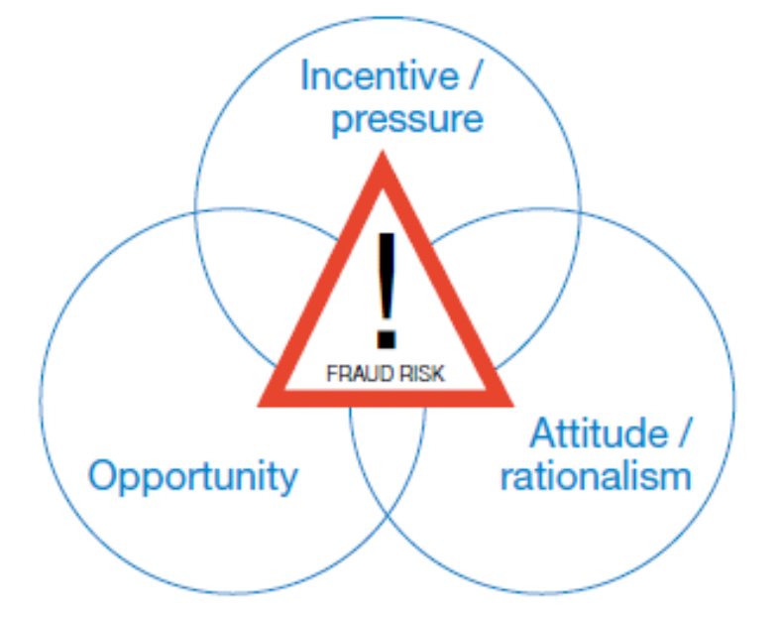
Causes of Fraud
Financial Reports - Relevance and Reliability in Audit
The Fraud Triangle:
Incentive / Pressure - management or other employees have an incentive or are under pressure that provides a reason to commit fraud
Opportunity - circumstances exist, such as the absence of controls, ineffective controls or the ability of management to override controls, which provide an opportunity for a fraud to be perpetrated.
Rationalization - those involved are able to rationalize a fraudulent act as being consistent with their personal code of ethics. Some individuals possess an attitude, character, or set of ethical values that allow them to knowingly and intentionally commit a dishonest act. However, even otherwise honest individuals can commit fraud in an environment that imposes sufficient pressure on them. The greater the incentive or pressure, the more likely an individual will be able to rationalize the acceptability of committing fraud
The Fraud Triangle describes three conditions that are generally present when fraud occurs

Slide 211
Before You Raise an Alarm
Financial Reports - Relevance and Reliability in Audit
Conduct further testing
Consult Manager
Secure audit evidence identified
Do not share results of testing with the business
Audit
Exception
Apply Professional skepticism
Engage Manager
Is this an indicator of fraud
No
Yes
Continue with procedures

Slide 212
15 Minutes
Accounting & Auditing Issues in JVs
We’ll resume our meeting in:

Slide 213
Risks and Control & Relevance to Audit of Upstream Contracts
Section 4
Audit Risks and Control
    An Organisation’s Control Framework
    Internal Control (COSO framework)
    COSO Enterprise Risk Management framework
    ORCA
    Risk Concepts and Risk Assessments
    5-Step Enterprise Risk Assessment Process
    Project/Process Risk Assessment Steps

Slide 214
Risks and Control & Relevance to Audit of Upstream Contracts
–
    An Organisation’s Control framework
102
Facilitator
Terkimbi
Time
15 minutes

Slide 215
An Organisation’s CONTROL Framework
Risks and Control & Relevance to Audit of Upstream Contracts
External Regulation and Legal Environment,
Business Code
Board, CEO and
Executive Committee
Statement on Risk Management
Code of Conduct
Standards, Manuals
and Guides
Compliance and Assurance
Delegation of Authority
Strategy, Planning &
Performance Appraisal
Business Function
Legal Entities
215
External Stakeholders
Foundation
Structure
Process

Slide 216
Risks and Control & Relevance to Audit of Upstream Contracts
–
    Internal Control (COSO framework)
102
Facilitator
Terkimbi
Time
15 minutes

Slide 217
COSO Definition of Control
Risks and Control & Relevance to Audit of Upstream Contracts
“A PROCESS,
effected by an entity's Board of Directors, management and other personnel,
designed to provide reasonable assurance regarding the achievement of objectives in the following categories:
  Effectiveness and efficiency of operations.
  Reliability of financial reporting.
  Compliance with applicable laws and regulations."

Slide 218
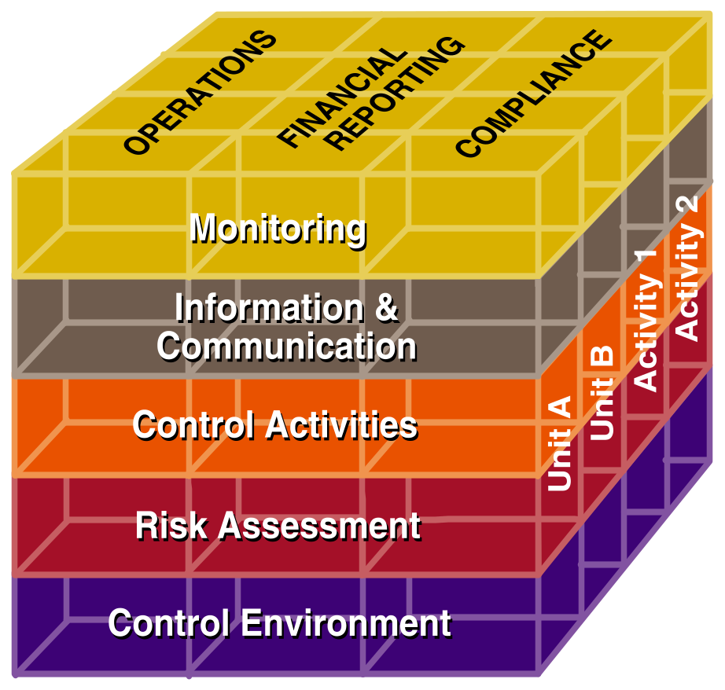
What does this framework mean?
Risks and Control & Relevance to Audit of Upstream Contracts
The COSO Internal Control Cube
Control Objectives
Organizational Structure
Components of Internal Control
Notes:
10

Slide 219
Control Environment
Risks and Control & Relevance to Audit of Upstream Contracts
  Sets the tone of an organization,
  influencing the control consciousness
  of its people.
  Factors include:
  Integrity & ethical values
  Management’s operating philosophy
  Organizational structure
  The way management assigns authority & responsibility
  HR policies & practices
  Competence of personnel
  The attention and direction provided by the board and Audit Committee
  Foundation for all other components of control
Operations
Financial
Compliance
Reporting
Monitoring
Information &
Communication
Control Activities
Risk Assessment
Control Environment
Notes:
11

Slide 220
Point of focus; an example of Control Environment
Risks and Control & Relevance to Audit of Upstream Contracts
Integrity and Ethical Values
  Existence and implementation of codes of conduct and other policies regarding acceptable business practices, conflicts of interest, or expected standards of ethical and moral behavior.
  Dealings with employees, suppliers, customers, investors, creditors, insurers, competitors, and auditors, etc. (e.g., whether management conducts business on a high ethical plane, and insists that others do so, or pays little attention to ethical issues).
  Pressure to meet unrealistic performance targets - particularly for short-term results – and extent to which compensation is based on achieving those performance targets.

Slide 221
Point of focus; an example of Control Environment
Risks and Control & Relevance to Audit of Upstream Contracts
Example of detailed points of focus:
  Codes are comprehensive, addressing conflicts of interest, illegal or other improper payments, anti-competitive guidelines, insider trading.
  Codes are periodically acknowledged by all employees.
  Employees understand what behaviour is acceptable or unacceptable, and know what to do if they encounter improper behaviour.
  If a written code of conduct does not exist, the management culture emphasizes the
  importance of integrity and ethical behaviour. This may be communicated orally in staff
  meetings, in one-on-one interface, or by example when dealing with day-to-day activities.

Slide 222
Risk Assessment
Risks and Control & Relevance to Audit of Upstream Contracts
A precondition to risk assessment is the establishment of objectives, linked at different levels and internally consistent
The identification and analysis of relevant risks to achievement of an entity’s objectives
Forms a basis for determining how risks should be managed
Mechanisms are needed to identify and address the special risks associated with managing change.
Operations
Financial
Compliance
Reporting
Monitoring
Information &
Communication
Control Activities
Risk Assessment
Control Environment
Notes:
12

Slide 223
Control Activities
Risks and Control & Relevance to Audit of Upstream Contracts
Policies/procedures that ensure mgmt. directives are carried out.
Control activities help ensure that necessary actions are taken to address risks.
Control activities occur throughout the organization, at all levels and in all functions.
  The range of activities include:
  -Approvals
  Authorizations
  Verifications
  Reconciliations
  Reviews of operating performance
  Segregation of duties
Operations
Financial
Compliance
Reporting
Monitoring
Information &
Communication
Control Activities
Risk Assessment
Control Environment
Notes:
14

Slide 224
Information & Communication
Risks and Control & Relevance to Audit of Upstream Contracts
Pertinent information is identified, captured and communicated in a timeframe that allows people to carry out their responsibilities.
    Includes internal and external information about events, activities and conditions necessary for informed business decision-making and external reporting.
    Effective communication must flow down, across & up the organization.
    There also needs to be effective communication with external parties such as customers, suppliers, regulators and shareholders.
Operations
Financial
Compliance
Reporting
Monitoring
Information &
Communication
Control Activities
Risk Assessment
Control Environment
Notes:
15

Slide 225
Monitoring
Risks and Control & Relevance to Audit of Upstream Contracts
Assessment of a control system’s performance over time.
Accomplished through a combination of ongoing monitoring activities, separate evaluations or a combination of the two.
Internal control deficiencies are reported upstream – serious matters reported to top mgmt. and the board.
The combination of ongoing and separate evaluations ensure the internal control system maintains effective over time.
Operations
Financial
Compliance
Reporting
Monitoring
Information &
Communication
Control Activities
Risk Assessment
Control Environment
Notes:
16

Slide 226
Risks and Control & Relevance to Audit of Upstream Contracts
The Five COSO Components of Control
Control environment - Tone at the top, Ethics, People quality, Locations
Risk assessment- Strategy setting, Objectives setting, Risk Assessment, Change management
Control activities - Policies & procedures, Management and supervision activities, Process controls design and execution
Information & Communication - Operational, financial, regulatory reporting, Quality, timeliness of data flows, Communication channels
Monitoring - External and internal audit, Other compliance & regulatory functions

Slide 227
COSO Enterprise Risk Management
Risks and Control & Relevance to Audit of Upstream Contracts
Developed as a response to a lack of common “risk” terminology and widely accepted principles that can be used by management to develop an effective risk management architecture
Incorporates COSO Internal Control framework
  5 of 8 components from original framework
  Internal Control is an integral part of ERM

Slide 228
Risks and Control & Relevance to Audit of Upstream Contracts
–
    COSO Enterprise Risk Management framework
102
Facilitator
Terkimbi
Time
Xx minutes

Slide 229
COSO Definition of Enterprise Risk Management
Risks and Control & Relevance to Audit of Upstream Contracts
“A PROCESS,
effected by an entity's board of directors, management and other personnel,
applied in strategy setting across the enterprise
designed to identify potential events that may affect the entity,
and manage risks to be within its risk appetite,
to provide reasonable assurance regarding the achievement of the entity objectives”

Slide 230
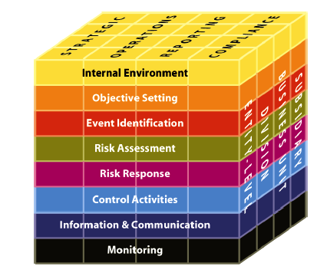
What does this framework mean?
Risks and Control & Relevance to Audit of Upstream Contracts
COSO Enterprise Risk Management Cube
4 Categories of Entity
Objectives
8 Components of Enterprise
Risk
Management
Notes:
10

Slide 231
What does this framework mean?
Risks and Control & Relevance to Audit of Upstream Contracts
COSO ERM
1) Internal Environment:
Risk Mgmt. Philosophy, Tone at the Top
2) Objective Setting
3) Event Identification:
Factors influencing strategy/objectives, Risk as opportunities
4) Risk Assessment: Inherent & residual risk, likelihood
5) Risk Response:
ID, evaluate and select risk response
6) Control Activities:
Integration with risk response, general & application controls
7) Info. & Communication:
Strategic & Integrated systems
8) Monitoring: Separate & ongoing evaluations
Notes:
10

Slide 232
Risks and Control & Relevance to Audit of Upstream Contracts
–
    ORCA
102
Facilitator
Terkimbi
Time
15 minutes

Slide 233

Risks and Control & Relevance to Audit of Upstream Contracts
ORCA

Slide 234
Risks and Control & Relevance to Audit of Upstream Contracts
The ORCA Process in Action
O
    Identify Objectives, considering all stakeholders
        organization, business unit, function, process;
R
C
A

Slide 235
Risks and Control & Relevance to Audit of Upstream Contracts
The ORCA Process in Action
O
    Identify Objectives, considering all stakeholders
        organization, business unit, function, process;
    Identify all the Risks that impact the organization’s ability to achieve its Objectives
R
C
A

Slide 236
Risks and Control & Relevance to Audit of Upstream Contracts
The ORCA Process in Action
O
    Identify Objectives, considering all stakeholders
        organization, business unit, function, process;
    Identify all the Risks that impact the organization’s ability to achieve its Objectives
    Identify the Controls that are required to mitigate these Risks;
    Determine that these Controls are in place and functioning, or
    Set an action plan to implement these controls;
    Think across all 5 COSO components of control
R
C
A

Slide 237
Risks and Control & Relevance to Audit of Upstream Contracts
The ORCA Process in Action
O
    Identify Objectives, considering all stakeholders
        organization, business unit, function, process;
    Identify all the Risks that impact the organization’s ability to achieve its Objectives
    Identify the Controls that are required to mitigate these Risks;
    Determine that these Controls are in place and functioning, or
    Set an action plan to implement these controls;
    Think across all 5 COSO components of control
    Alignment of the Objectives, Controls & Risks
    Verify that the controls are addressing the risks
R
C
A

Slide 238
ORCA - Objectives, Risks, Controls/Processes, Alignment
Risks and Control & Relevance to Audit of Upstream Contracts
Focuses on how organizations, business units, business processes or individuals describe and prioritize their strategies and objectives.
Is founded on the premise that risks must be taken in pursuit of opportunities
Helps organizations to create specific internal controls to respond to potential threats and opportunities
Helps organizations to align their strategic objectives with their own risks, controls and processes

Slide 239
Risks and Control & Relevance to Audit of Upstream Contracts
–
    Risk Concept and Risk Assessment
102
Facilitator
Terkimbi
Time
15 minutes

Slide 240
Risk: The collection of internal and external factors, which affects the ability of an organization to meet its objectives.
Risks and Control & Relevance to Audit of Upstream Contracts
Risk Defined
Inherent Risk:
Residual Risk:

Slide 241
Risk: The collection of internal and external factors, which affects the ability of an organization to succeed.
Risks and Control & Relevance to Audit of Upstream Contracts
Risk Defined
Inherent Risk:
The risk present in conducting certain business activities.
The risk to an entity in the absence of any actions management might take to alter either the risk’s likelihood or impact. (Source: COSO ERM Framework)
Residual Risk:

Slide 242
Risk: The collection of internal and external factors, which affects the ability of an organization to succeed.
Risks and Control & Relevance to Audit of Upstream Contracts
Risk Defined
Inherent Risk:
The risk present in conducting certain business activities.
The risk to an entity in the absence of any actions management might take to alter either the risk’s likelihood or impact. (Source: COSO ERM Framework)
Residual Risk:
The risk that remains from inherent risk after the effect of a previously substantiated internal control structure is considered.
The risk that remains after management responds to the risk. (Source COSO ERM Framework)

Slide 243
Classification of Risk
Risks and Control & Relevance to Audit of Upstream Contracts
Risk as opportunity is implicit in the concept that a relationship exists between risk and return. Managing risk means using techniques to maximize the upside within the organizations operating environment.
Risk as hazard refers to potential negative events such as financial loss, injury on the job site. Managing risk means installing techniques/procedures to reduce the probability of the negative event occurring.
Risk as uncertainty refers to the distribution of all possible outcomes. In this context, managing risk seeks to reduce the variance between anticipated outcomes and the actual results.

Slide 244

Risk Concepts & Theory
Risks and Control & Relevance to Audit of Upstream Contracts

Slide 245
What is a Risk Assessment?
Risks and Control & Relevance to Audit of Upstream Contracts
A Risk Assessment is:
A summary of business objectives, risks and controls as articulated by management and employees through interviews or questionnaires
A method for determining how audit resources should be deployed to review a specific business process or functional area
The beginning step of process and control analysis
The first step towards effective risk management

Slide 246
What is not a Risk Assessment?
Risks and Control & Relevance to Audit of Upstream Contracts
A Risk Assessment is not:
A detailed review of a specific business process
A conclusion on the business process and controls
A validation of statements made during the management and staff interview process
Not the performance of detailed testing of transactions related to the process
Not the end step of process and control analysis

Slide 247
Types of Risk Assessments
Risks and Control & Relevance to Audit of Upstream Contracts
Enterprise Level
Project Level
    Business Unit
    Business Process

Slide 248
Types of Risk Assessments
Risks and Control & Relevance to Audit of Upstream Contracts
Enterprise Level –
    used to identify and prioritize the objectives and risks affecting the organization and in turn, develop the audit plan.
    can also be used to identify and prioritize the business units having the most impact on the organization’s objectives and risks. These business units may be subject to further risk assessment, such as at the business unit or business process level.

Slide 249
Types of Risk Assessments
Audit Risks and Control & Relevance to Audit of Upstream Contracts
Project Level – used to identify and prioritize the business risks relating to a business unit or process.
    Business Unit Level – Risk assessment designed to identify risks within the business units (e.g. product line, geographic location).
    Business Process Level – This level is used to determine the risk profile at the business process level.

Slide 250
Benefits of a Risk Assessment
Risks and Control & Relevance to Audit of Upstream Contracts
Provides additional financial and operational information to the Audit Committee
Increases awareness and creates a common understanding of business risk throughout the Company
Facilitates understanding of the need to identify and manage risks
Provides information to drive future internal audit activities (and sell PAA services!!!)

Slide 251
Risks and Control & Relevance to Audit of Upstream Contracts
–
    5-Step Enterprise Risk Assessment Process
102
Facilitator
Terkimbi
Time
15 minutes

Slide 252
Step 1: Planning
Risks and Control & Relevance to Audit of Upstream Contracts
Obtain an overview and identify Risk Factors related to:
    The Client
    Competitors
    Industry

Slide 253
Internal Factors
Risks and Control & Relevance to Audit of Upstream Contracts
Step 1: Planning
  General info. on the client and its management
  Ownership structure and related issues
  Principal business strategies
  Operations, technology, finance, marketing & personnel
  Recent and contemplated changes in business processes & systems
  Known risk and control issues

Slide 254
Industry Factors
Risks and Control & Relevance to Audit of Upstream Contracts
Step 1: Planning
Supplier, competitor and customer dynamics
Industry conditions and trends
Technology
Client's position in the market

Slide 255
External Factors
Risks and Control & Relevance to Audit of Upstream Contracts
Step 1: Planning
Economic factors outside of the client's control
Legislative/regulatory issue
Social/environmental issues

Slide 256
Identify Client Expectations
Risks and Control & Relevance to Audit of Upstream Contracts
Step 1: Planning
Scope & Approach – bottom-up or top-down; interviews, facilitated group sessions or self assessment surveys; whether client staff will be included as project team members
Deliverables – formal or informal; oral or written; narratives or graphics; entity-wide or business unit / geography focused
Timing of deliverables – progress reports, vetting drafts, distribution dates
Value of recent risk assessments – If the audit committee and Shareholder representative. management see great value from the last risk assessment, then take care not to tinker with something that is already considered to be effective
Inquire if other departments at the client, such as strategic planning, budgeting, or risk / insurance are already performing their own type of risk assessments. You may discover great value and efficiencies in leveraging off of their experiences & deliverables

Slide 257
Creating a Detailed Work Plan
Risks and Control & Relevance to Audit of Upstream Contracts
Step 1: Planning
Confirm that your earlier discussions with the IA stakeholders have resulted in an understanding of the
      Approach
      Scope
      Information gathering methods and number of interviews
      Data collection techniques
      Areas / topics to include/exclude
      Deliverable formats
      Etc.

Slide 258
Creating a Detailed Work Plan
Risks and Control & Relevance to Audit of Upstream Contracts
Step 1: Planning
Review the client organization structure to identify key management to participate in interviews, surveys and/or facilitated sessions.
  Specific inquiries and consideration to fraud should be made in the risk assessment process.
  Incorporate into the work plan the timetables, budgets, interview schedules, resource requirements, interim deliverables and other pertinent planning issues.
  Develop agendas, placemats and/or questionnaires for use in meetings with client personnel to ensure consistent information gathering techniques.
  Distribute the surveys and establish a process for managing responses. This will result in a survey participant / response control worksheet
  Schedule the meetings
  Design and prepare for facilitated sessions, if any.

Slide 259
Step 2: Gather Information and Identify Risk
Risks and Control & Relevance to Audit of Upstream Contracts
Interviews
Facilitated Sessions
Surveys

Slide 260
3. Evaluate - Creating the Risk Profile
Risks and Control & Relevance to Audit of Upstream Contracts
  Determine whether the risk profile should be based on inherent or residual risk
  Determine the organization’s appetite for, and tolerance of risks
  Note the key business objectives or concerns noted by management during the interviews
  Note any key system or process changes
  Determine the importance of risk from management’s viewpoint

Slide 261
3. Evaluate - Assessing the Relative Level of Risk
Risks and Control & Relevance to Audit of Upstream Contracts
  Review all of your notes and documentation created from the information gathering process. Categorize the information in a list or table.
  Sort the individual notes into similar groups or themes.
  Examine the list to ensure there are not any significant risks missing.
  Give each item a theme or numerical ranking. Choose a system that is intuitive to you and your client.
  Begin the iterative process of analyzing your results, changing the rankings that appear inconsistent and the re-sorting your list until you are satisfied
  Share your ranked results with others to help ensure that the rankings reflect the comments heard during the information gathering process.
  If you will be reporting results using a heat map or chart, study the numerical results and determine the formulas to be used to translate the scores into colors or positions on the chart

Slide 262
Step 4: Develop the Audit Plan
Risks and Control & Relevance to Audit of Upstream Contracts
Balance between IA’s Mission and Resources
Flexible Plan
Communicate to the Audit Committee
Consider Timing of Audits vs. Audi tee Activities
Periodic Re-Assessment of Risks and Audit Plan

Slide 263
Step 5: Reporting the Results

Slide 264
Risks and Control & Relevance to Audit of Upstream Contracts
–
    Project Level Risk Assessment Process
102
Facilitator
Terkimbi
Time
15 minutes

Slide 265
Project Level Risk Assessment
Risks and Control & Relevance to Audit of Upstream Contracts
  Step 1 – Gather Information
  Step 2 – Identify Business and Control Objectives
  Step 3 – Identify Risks
  Step 4 – Identify Controls
  Step 5 – Evaluate Risks
  Step 6 – Develop Potential Audit Procedures
  Step 7 – Create Audit Program

Slide 266
Step 1: Gather Information - The Client
Risks and Control & Relevance to Audit of Upstream Contracts
  Client Interviews - Information Needed:
    Identify process owners – has there been any significant employee turnover, Non Operated Venture partners er
    Determine systems used
    Identify existing policies and procedures
    Identify any related Company workgroups current/past
    Determine any major past/future process changes

Slide 267
Step 1: Gather Information - The Client
Risks and Control & Relevance to Audit of Upstream Contracts
  Client Documents/Reports:
    Financial Statements – identify financial statement accounts affected by process to determine the materiality of accounts
    Identify financial trends
    Prior Internal Audit reports
    External auditor management letters
    Existing Sarbanes-Oxley documentation
    Client web site – press releases

Slide 268
Step 2: Identify Business & Control Objectives
Risks and Control & Relevance to Audit of Upstream Contracts
Identify business and control objectives through interviews, research and professional judgement.
    Objectives may be articulated in a variety of organization documents including the organization mission statement, enterprise plan, Balanced Scorecard Initiatives, business plans and budgets.
  Use COSO Internal Control Definitions as a guide:
    Effectiveness and Efficiency of Operations
    Reliability of Financial Reporting
    Compliance with applicable Laws and Regulations

Slide 269
Step 3: Identify Risks - What are the Key Risks Affecting the Process?
Risks and Control & Relevance to Audit of Upstream Contracts
Interview Management & Key Process Owners
    Areas of concern
    Why was process selected for review?
    Past instances of fraud
Consult with experts
Review examples of relevant audit programs and relevant publications

Slide 270
Step 4: Identify Controls – Keep in Mind the COSO Control Environment
Risks and Control & Relevance to Audit of Upstream Contracts
  Risk Assessment- Determine how management identifies and assesses risks.
  Control Activities- Through interviews, reviews of documented policies and procedures and research to determine current controls in place and compare to best practice controls.
  Information and Communication- Identify internal and external communication (e.g., Management Reports, Customer Surveys)
  Monitoring- Identify existing or best practice management and supervisory activities

Slide 271
Step 5: Evaluate Risks
Risks and Control & Relevance to Audit of Upstream Contracts
  Determine which risks have the highest likelihood of occurring and impact if it were to occur
  Each risk should be ranked as High, Moderate or Low

Slide 272
Step 6: Develop Potential Audit Procedures

Slide 273
Step 7: Create Audit Program

Slide 274
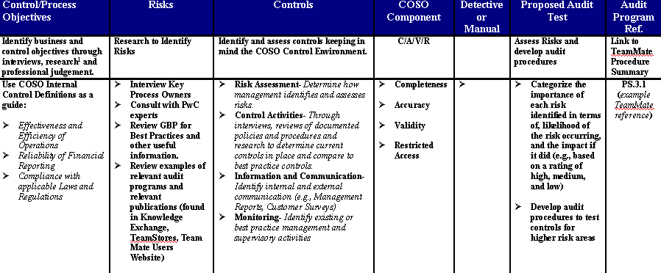
The Risk Matrix – Incorporates both ORCA & COSO
Risks and Control & Relevance to Audit of Upstream Contracts

Slide 275
Risks and Control & Relevance to Audit of Upstream Contracts
Section 7
Application of Risks and Control to Joint Venture (JV) Audits

Slide 276
Risks and Control & Relevance to Audit of Upstream Contracts
–
    Basic Building Block for JV Audit
102
Facilitator
Terkimbi
Time
15 minutes

Slide 277
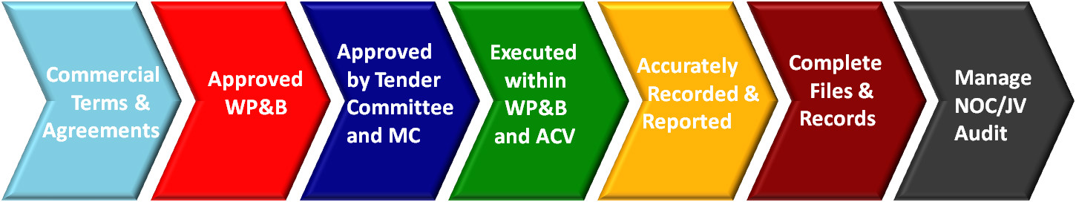
Risks and Control & Relevance to Audit of Upstream Contracts
Basic Building Block for JV Audit

Slide 278
Risks and Control & Relevance to Audit of Upstream Contracts
Focus of Joint Venture Audits:
  Compliance review to assess whether the Operator has materially complied with the JV Operating Agreement
  Primary focus on Cost Allocations
  Secondary focus on effectiveness of internal controls
  Scope is defined by Operator Billing Statements / P&L and Balance Sheet
  2nd Line of Defence assurance activity

Slide 279
Risks and Control & Relevance to Audit of Upstream Contracts
Planning phase
Communicate timely with Operator and Partners
  Lead Auditor to send out Audit Notification or draft Terms of Reference
Get overview of the audit scope
  Review JV related agreements and accounting principles
  Review previous Audit Reports
  Discuss audit with previous Audit Lead
  Review management information reports, info from JV and finance committee meeting minutes, JV billings for the period under review
  Arrange meeting with Shareholder representative and FM to identify any high risk areas

Slide 280
Risks and Control & Relevance to Audit of Upstream Contracts
Planning phase
Agree Terms of Reference (ToR) with Operator and participating partners
Prepare the Audit team
A typical audit team is made up of a Lead Auditor and 2-3 audit US$ Teams can be fully Audit team staffed or contain partner auditors, depending on the JV.
  Re-confirm auditors availability
  Check potential conflict of interest of audit team members
  Delegate scope based on auditors experience, preference for audit areas, development aspirations
Prepare Data files
  Obtain transaction files from Operator
  Reconcile transaction files to Billing Statements / P&L and Balance Sheet
  Distribute to auditors in line with delegated scope

Slide 281
Risks and Control & Relevance to Audit of Upstream Contracts
Planning phase
Clarify and agree the practicalities
  Audit locations
  Start and closing dates/meetings
  Travel details
  HSSE
  Access to operator’s systems
Arrange team briefing meeting
  Discuss audit scope & key risk areas
  Distribution of tasks
  Requirements with regard to audit file & working papers
  Audit practicalities (see above)

Slide 282
Risks and Control & Relevance to Audit of Upstream Contracts
Planning phase
Prepare for the on-site visit
  Ensure team is aware of HSSE & working conditions on-site
  Plan transportation from and to on-site location in advance
  Clarify and agree specific requirements for the team
  Ensure wireless internet access is available

Slide 283
Risks and Control & Relevance to Audit of Upstream Contracts
Planning phase
Build the Audit Test Program (sample)
EXPENDITURE Category Class | Total Amount (mEUR) | Risk based on Size H/M/L | Risk based on Complexity H/M/L | Basis for decision Complexity | Key Focus Area | Basis for decision Key Focus Area | Sampling | Who | Status | Outstanding Items/comments
OPEX |  |  | Click to Select |  | Click to Select |  |  |  | Click to Select
Direct Expenditure
Operate wells and facilities | 201 | High | Low | <text> | No | <text> | Test 25 items | John Johnson | Not Started | <text>
Maintain facilities | 36 | Medium | High |  | Yes | Two monetary findings in 2012 audit report | Test min. 80% of total expenditure | Anna Beard | Completed | -
Maintain wells | 110 | High | Low |  | No |  | Test 25 items | Anna Beard | Not Started
Throughput charges / tariffs | 45 | High | Low |  | No |  | Test 25 items | John Johnson | Completed
Insurance | 32 | Medium | Low |  | No | FM indicated unclear allocation procedure | Test 15 items | Steve Deer | In Progress | 6/10 Insurance invoices to be received
Development studies / feasex | 26 | Medium | Low |  | No |  | Test 15 items | John Johnson | Not Started
Other direct | 69 | High | Low |  | No |  | Test 25 items | Anna Beard | Not Started | -

Slide 284
Risks and Control & Relevance to Audit of Upstream Contracts
Planning phase
Build the Audit Test Program (cont’d)
  1. Build the cost category spreadsheet
  2. Risk based on size depends on relative size of the expenditure class compared to total expenditures and is calculated automatically
1
2
EXPENDITURE Category Class | Total Amount (mEUR) | Risk based on Size H/M/L | Risk based on Complexity H/M/L | Basis for decision Complexity
OPEX |  |  | Click to Select
Direct Expenditure
Operate wells and facilities | 201 | High | Low | <text>
Maintain facilities | 36 | Medium | High
Maintain wells | 110 | High | Low
Throughput charES / tariffs | 45 | High | Low
1

Slide 285
Risks and Control & Relevance to Audit of Upstream Contracts
Planning phase
Build the Audit Test Program (cont’d)
  3. Risk based on complexity (High/Medium/Low) is based on:
    Type of expense
    Allocation method used
    Level of judgment involved
    Complexity of accounting procedure
    Specific arrangements mentioned in JV Agreement
EXPENDITURE Category Class | Total Amount (mEUR) | Risk based on Size H/M/L | Risk based on Complexity H/M/L | Basis for decision Complexity
OPEX |  |  | Click to Select
Direct Expenditure
Operate wells and facilities | 201 | High | Low | <text>
Maintain facilities | 36 | Medium | High
Maintain wells | 110 | High | Low
Throughput charES / tariffs | 45 | High | Low
1
3

Slide 286
Risks and Control & Relevance to Audit of Upstream Contracts
Planning phase
Build the Audit Test Program (cont’d)
  4. Whether expenditure class is a Key Focus Area, depends on:
  Previous audit findings
  Other input obtained during planning phase (OCM minutes, MI reports)
  5. Testing sample is generated automatically based on expenditure class size, complexity and Key Focus Area.
5
Key Focus Area | Basis for decision Key Focus Area | Sampling
Click to Select
No | <text> | Test 25 items
Yes | Two monetary findings in 2012 audit report | Test min. 80% of total expenditure
No |  | Test 25 items
No |  | Test 25 items
4

Slide 287
Risks and Control & Relevance to Audit of Upstream Contracts
Planning phase
Build the Audit Test Program (cont’d)
  6. Shows person responsible for performing monetary testing for a specific expenditure class
  7. Shows whether testing for a specific expenditure class is completed, in progress or ‘not started’.
  8. Details on information to be received, number of samples still to be tested etc.
  9. Details on monetary and procedural findings
9
Who | Status | Outstanding Items/comments | Monetary Findings | Procedural Findings
 | Click to Select
John Johnson | Not Started | <text> | <text> | <text>
Anna Beard | Completed | - | No findings | No findings
Anna Beard | Not Started
John Johnson | In Progress | 6/10 Insurance invoices to be received
6
7
8

Slide 288
Questions

Slide 289
Thank You
Notes:
289

